Slide 1

Times Tables
Why are they important?

Slide 2

Why Focus on Times Tables?
Times tables are a cornerstone of mathematics.
They underpin many areas of maths, including
division, fractions and algebra.
Quick recall builds confidence and reduced frustration.

Slide 3
Benefits of Learning Times Tables
Faster problem solving. Having a secure understanding of times tables means children are able to solve calculation more quickly.
Stronger number sense. Children are able to understand relationships between numbers and ‘see’ links.
Secure foundations. These provide the children will the skills needed for many areas of maths including division, long multiplication, decimals, fractions, percentages, algebra, etc.

Slide 4
Real World Applications
Budgeting: Calculating costs for multiple items.
Time Management: Multiplying hours and minutes.
Measurement: Converting between units (e.g., cm to metres).
Interactive Question: 'How many wheels are there on 8 bicycles?'

Slide 5
Times Tables in school
The national curriculum lays out expectations for times tables fluency by age:
Y2 – x2, x5 and x10
Y3 – x3, x4 and x8
Y4 – all tables to x12

Slide 6
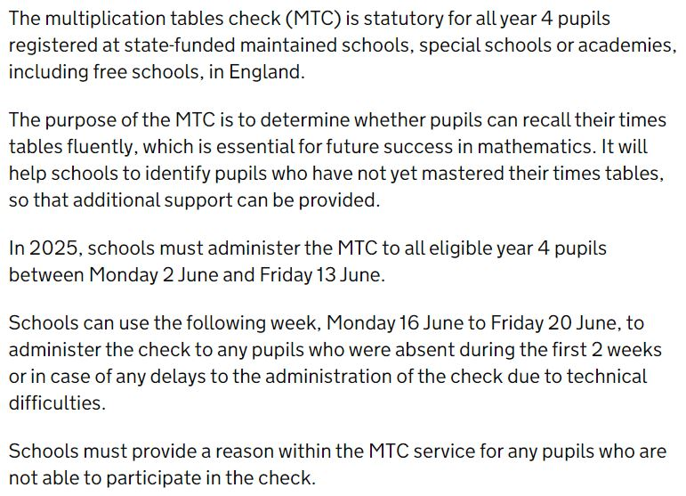
Multiplication Times Tables Check

Slide 7

Times Table Rock Stars
Times Table Rock Stars is an exciting game which helps children to learn and practise their times tables. Through a “little and often” approach, children secure their times table knowledge whilst having fun!
Children from Y2-Y6 have 15 minutes of TTRS homework each week.
You can download the app from the app store or play on the Times Table Rock Stars game on their website.

Slide 8
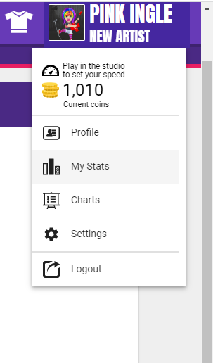
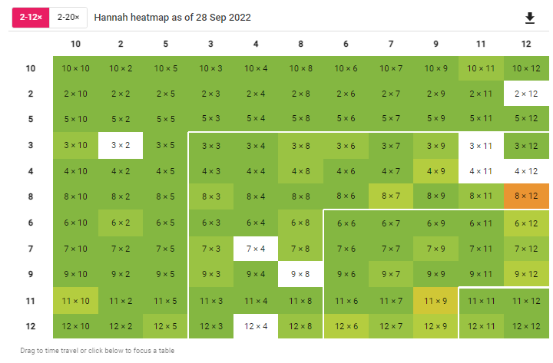
Checking your child’s progress
Checking your child’s progress is easy:
When your child has logged in, select their avatar in the top right hand corner and then select the ‘My Stats’ option.
In the effort tab, you can see how many minutes the children have played.
Under fluency, you can see how quickly your child is able to answer each question and how confident they are with their individual times table knowledge.

Slide 9
x and ÷ go hand in hand!
Once children know the tables, they also know the division facts
It is important for the children to practise these facts and that is why TTRS also asks division questions
Division is the same as asking how many groups make a total
24÷6. we calculate using the inverse, asking how many 6s make 24? ? X 6 = 24
81÷9. How many 9s make 81? ? X 9 = 81

Slide 10
How can you help at home?
Help with chanting, singing etc., to memorise times tables. Chant the table in order to commit it to memory.
Do a bit at a time – commit the first few to memory and then add two more facts. Then add more until your child can confidently chant the complete table.
Now you can mix up the order of the table. If 4x6 = 24, what goes next? If 7x6=42, what goes next?
Then you can quick fire the table in a random order and practise, practise, practise to memorise the table.

Slide 11
How can you help at home?
Remind your child that multiplication is commutative – meaning it can be reversed, so 5x7 becomes 7x5. This means they can reduce the number of tables they have to memorise!
Create opportunities in daily life – e.g. doubling recipes, helping with the shopping
Play games to support the learning of each times table in turn
Use computer games or apps to support learning

Slide 12
Websites to support children’s maths skills
CBeebies have lots of fun and interactive games and activities to help get our younger children excited about Maths
BBC Bitesize – lots of information alongside short videos help to make the learning enjoyable and accessible for all children
Maths Zone – this site is jam-packed with fun ways to learn more about maths.
I See Maths – a useful site with a plethora of ideas for fun games that all the family
Hit the Button – children love this game as it helps to increase confidence through practising times tables and number bonds.

