Slide 1
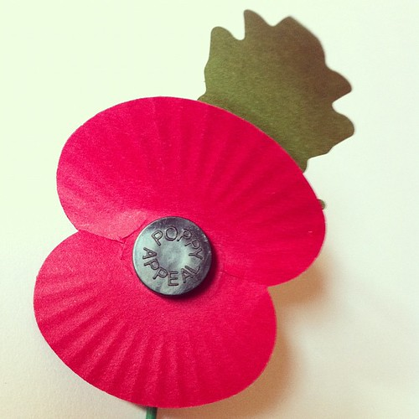
Remembrance poppies house art competition
2023

Slide 2

In a few weeks on the 11.11.23 it will be Remembrance Day.
You are invited to create any piece of art work that shows poppies.
We know that you are all talented artists and we would like to display your artwork in school.
Here are some ideas;

Slide 3
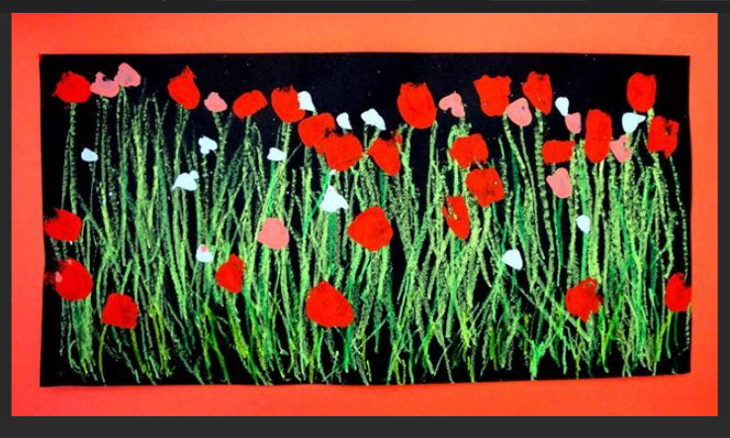
Chalk and paint

Slide 4
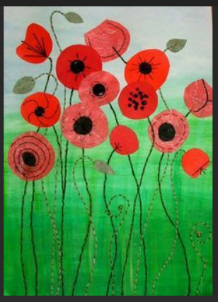
Different types of red paper/fabric with added stitching but you could add details with pen/buttons/recycled bits of packaging

Slide 5
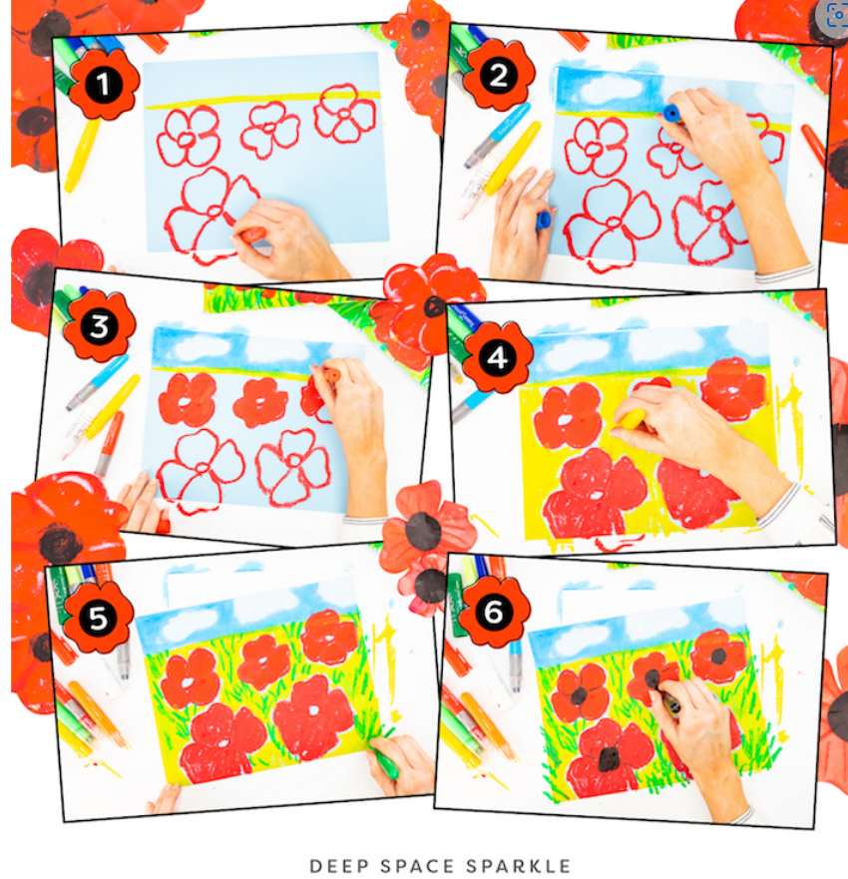
Wax crayons/ oil pastels/ coloured pencils/ felt tips or a mixture of all of them.

Slide 6
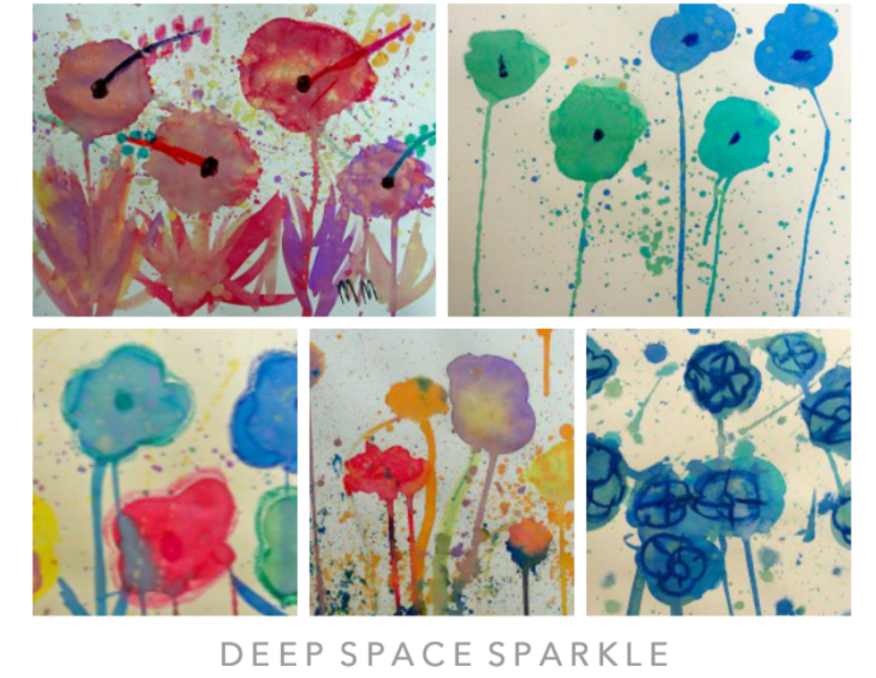
Water colour and wax crayon.

Slide 7
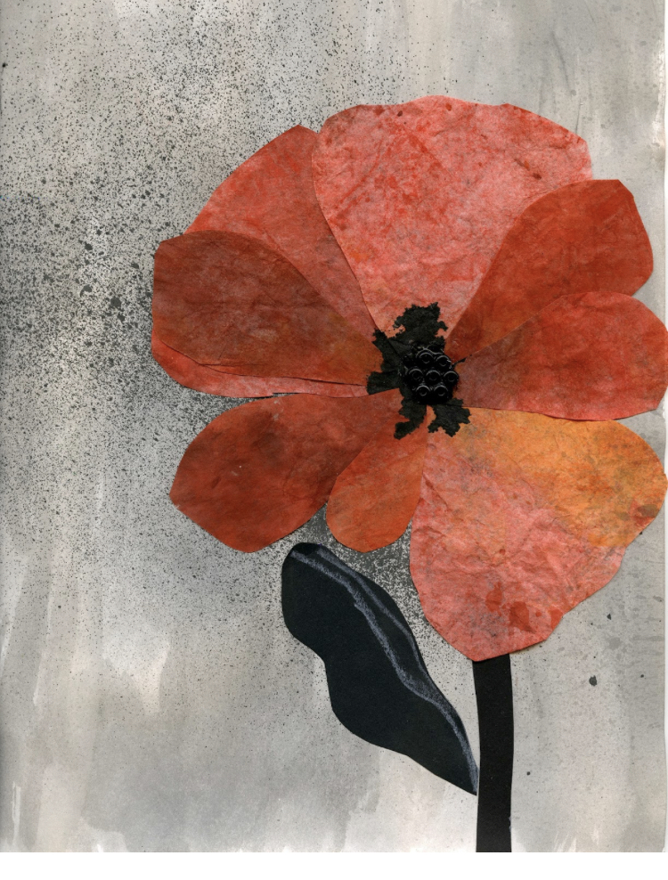
Tissue paper and paint splatter. You could use wrapping paper or food packets/sweet wrappers too.

Slide 8
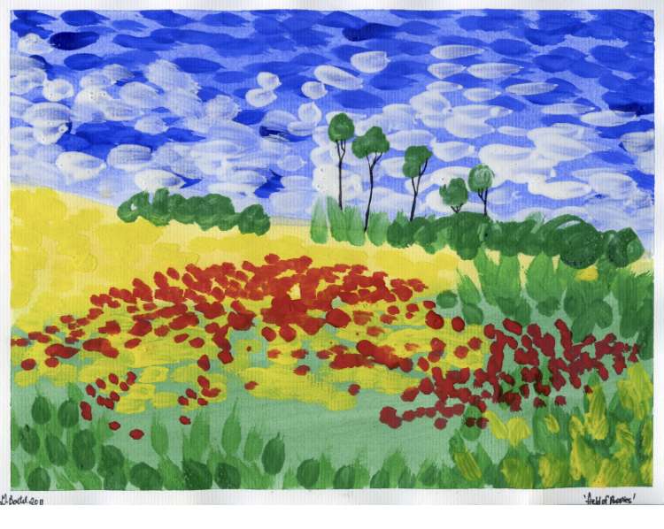
Impressionist style with marks, dots and dashes.

Slide 9
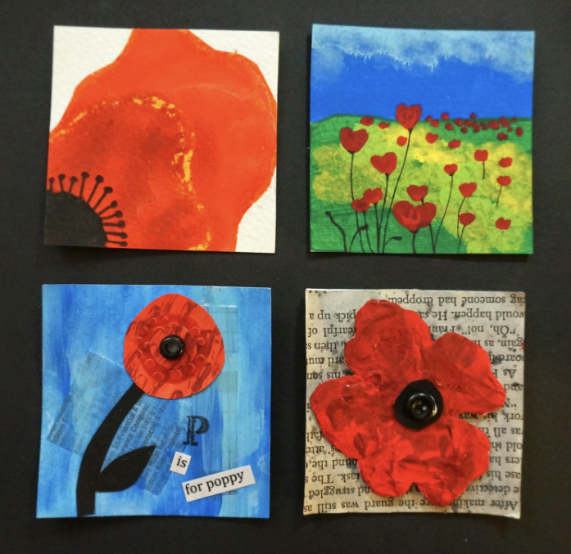
All entries need to be in by the Tuesday following half term: 7th of November.
Each class will have a first, second and third place.
This gives us time to display your work for remembrance day.

