Slide 1


Year 1 – Summer Block 3 – Position and Direction
Step 1: Describe Turns
© Classroom Secrets Limited 2018

Slide 2
Introduction
Stand up and face the front of the classroom. Follow these instructions. Which ones make a full turn?
 | Instructions | Full turn?
1 | Make a quarter turn. Make a half turn in the same direction. Make another half turn in the same direction.
2 | Make a half turn. Make a quarter turn in the same direction. Make another quarter turn in the same direction.
3 | Make a three quarter turn. Make a half turn in the same direction.
© Classroom Secrets Limited 2018

Slide 3
Introduction
Stand up and face the front of the classroom. Follow these instructions. Which ones make a full turn?
 | Instructions | Full turn?
1 | Make a quarter turn. Make a half turn in the same direction. Make another half turn in the same direction. | X
2 | Make a half turn. Make a quarter turn in the same direction. Make another quarter turn in the same direction. | ✓
3 | Make a three quarter turn. Make a half turn in the same direction. | X
© Classroom Secrets Limited 2018

Slide 4
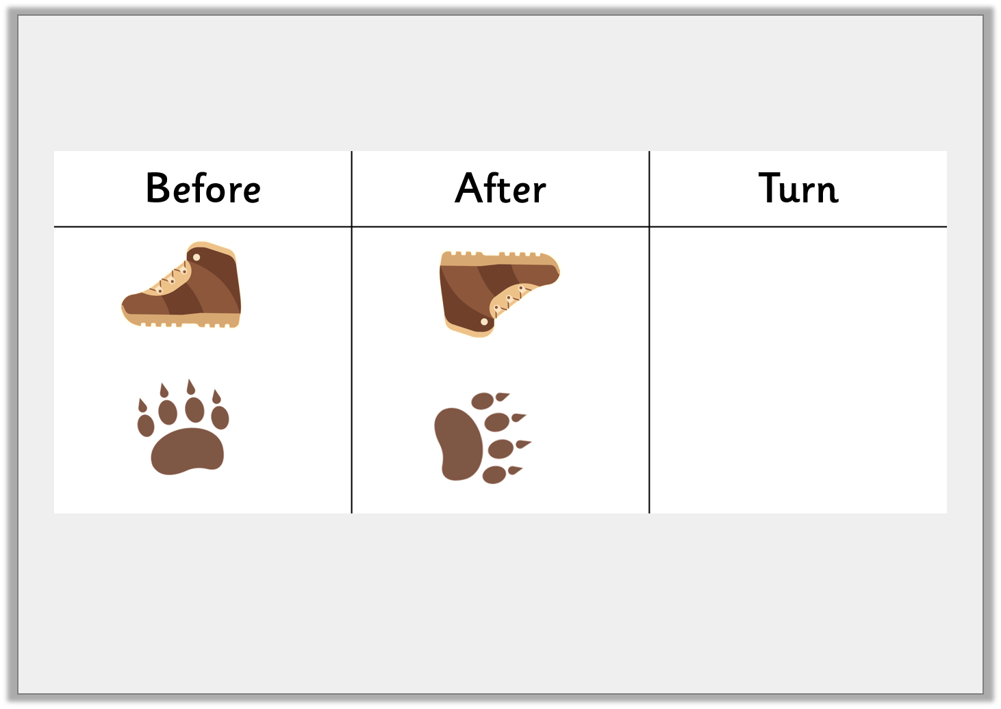
Varied Fluency 1
Look at the objects below. How have they moved?
Write the correct turn for each object.
© Classroom Secrets Limited 2018

Slide 5
Varied Fluency 1
Look at the objects below. How have they moved?
Write the correct turn for each object.
Half turn
Quarter
turn
© Classroom Secrets Limited 2018

Slide 6
Varied Fluency 1
Look at the objects below. How have they moved?
The paw print may also make a three-quarter turn to the left.
Write the correct turn for each object.
Half turn
Quarter
turn
© Classroom Secrets Limited 2018

Slide 7
Varied Fluency 2
Draw this shape after a quarter turn.
© Classroom Secrets Limited 2018

Slide 8
Varied Fluency 2
Draw this shape after a quarter turn.
© Classroom Secrets Limited 2018

Slide 9
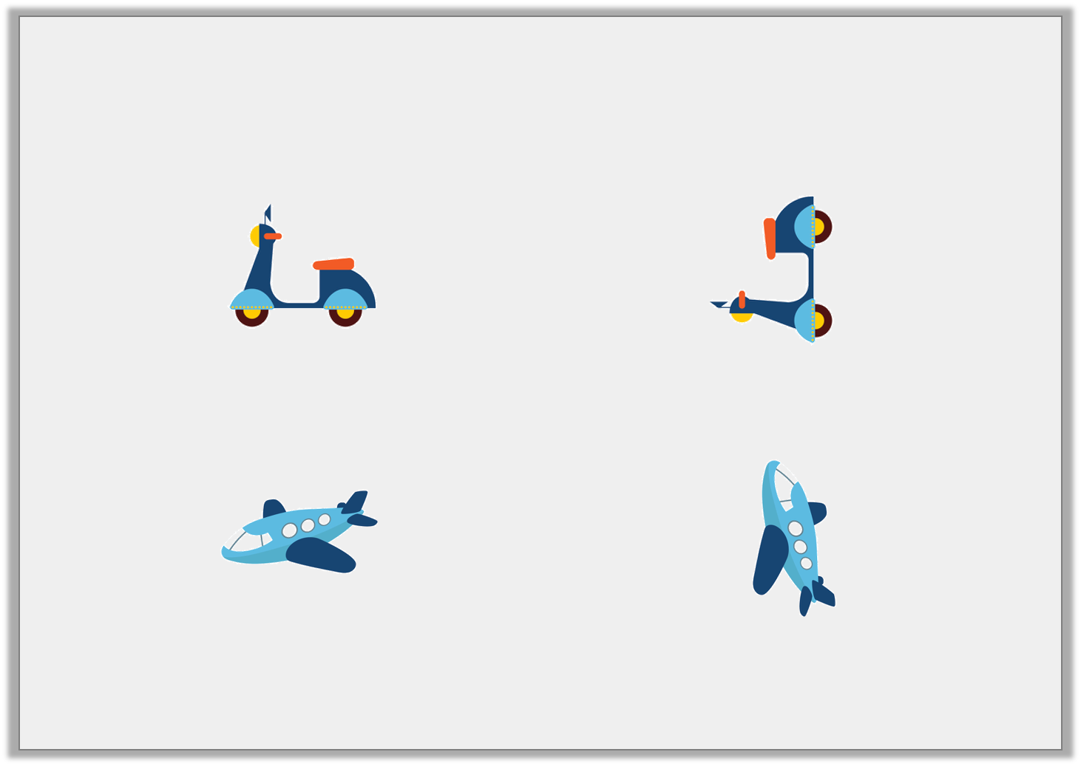
Varied Fluency 3
Draw an arrow in the box to show
the direction each object has turned.
Describe the turn each object has made.
© Classroom Secrets Limited 2018

Slide 10
Varied Fluency 3
Draw an arrow in the box to show
the direction each object has turned.
A quarter turn
A quarter turn
Describe the turn each object has made.
© Classroom Secrets Limited 2018

Slide 11
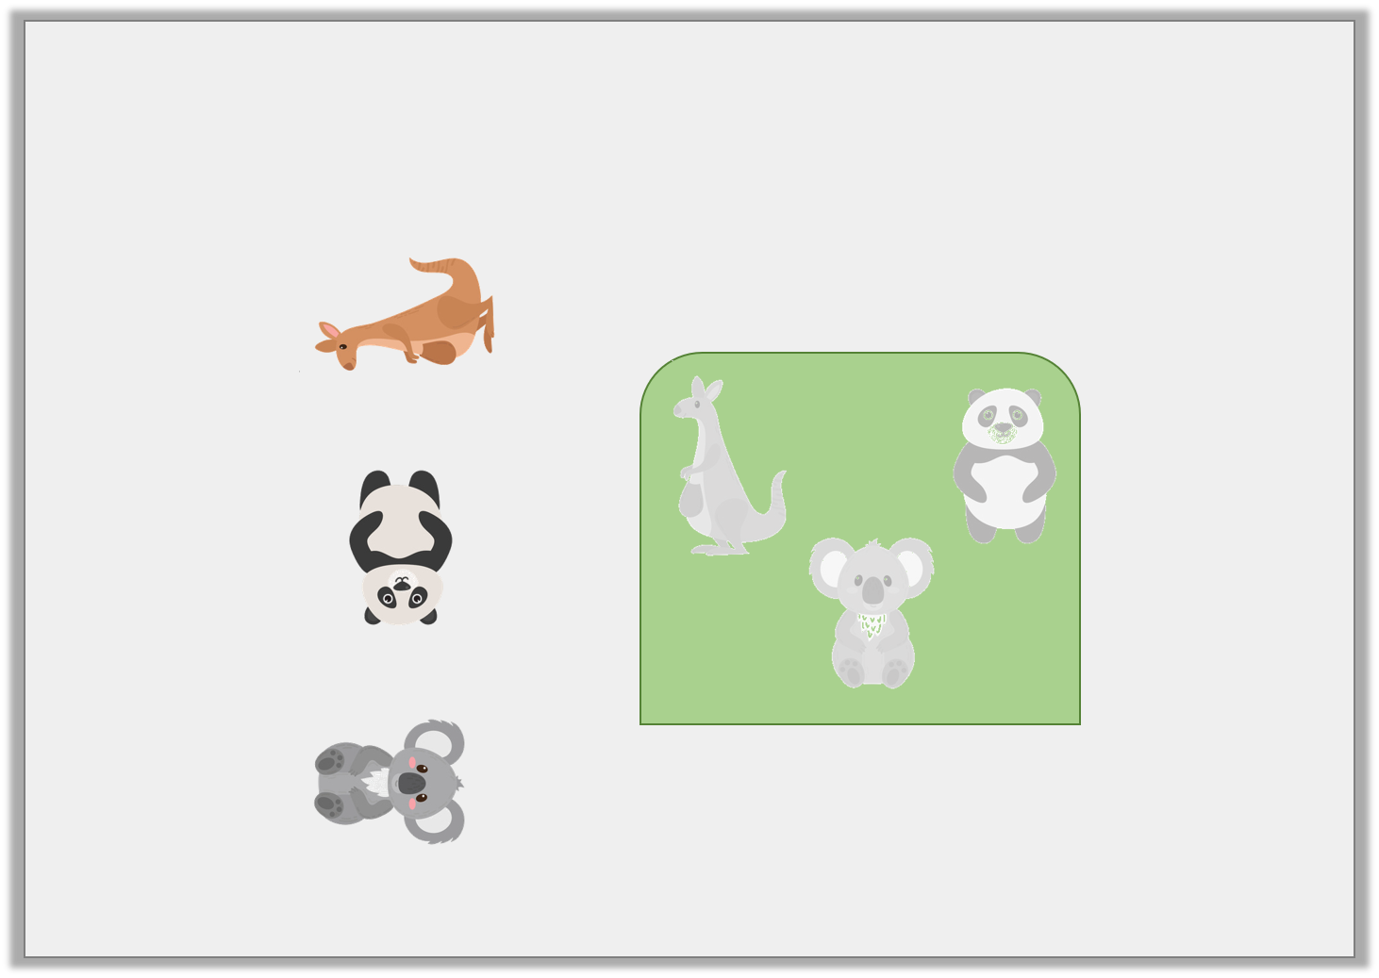
Problem Solving 2
The jigsaw pieces need to turn to fit their space.
How should they each turn?
© Classroom Secrets Limited 2018

Slide 12
Problem Solving 2
The jigsaw pieces need to turn to fit their space.
How should they each turn?
a quarter turn
a half turn
a quarter turn
© Classroom Secrets Limited 2018

