Slide 1


Year 1 – Spring Block 1 – Addition and Subtraction
Step 4: Subtraction – Not Crossing 10
© Classroom Secrets Limited 2018

Slide 2

Reasoning 1
Bella is writing a number sentence to describe the image below.
Is she correct? Prove it.
16 – 5 = 11
– 5
10 | 11 | 12 | 13 | 14 | 15 | 16 | 17 | 18 | 19 | 20
© Classroom Secrets Limited 2018

Slide 3
Reasoning 1
Bella is writing a number sentence to describe the image below.
Is she correct? Prove it.
Bella is correct because…
16 – 5 = 11
– 5
10 | 11 | 12 | 13 | 14 | 15 | 16 | 17 | 18 | 19 | 20
© Classroom Secrets Limited 2018

Slide 4
Reasoning 1
Bella is writing a number sentence to describe the image below.
Is she correct? Prove it.
Bella is correct because the number line shows 16 – 5 = 11.
16 – 5 = 11
– 5
10 | 11 | 12 | 13 | 14 | 15 | 16 | 17 | 18 | 19 | 20
© Classroom Secrets Limited 2018

Slide 5
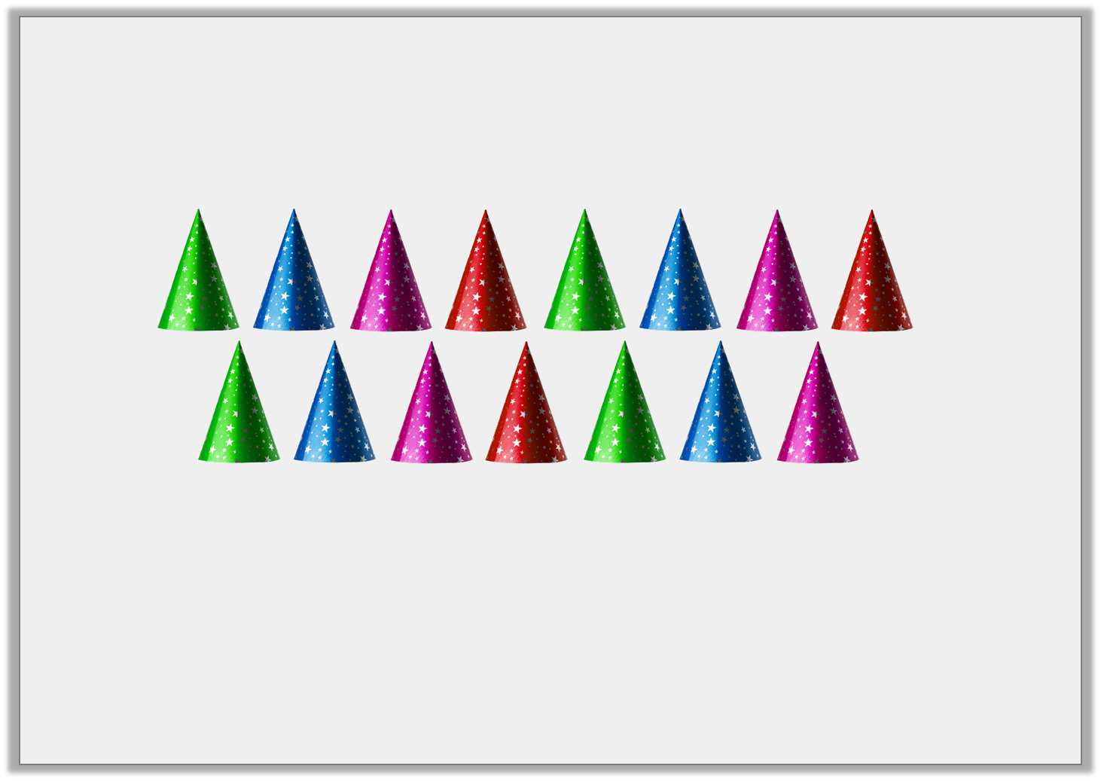
Problem Solving 1
Jo has a pack of 15 party hats. She uses 4 hats.
Write a subtraction sentence to show this.
 | – |  | =
© Classroom Secrets Limited 2018

Slide 6
Problem Solving 1
Jo has a pack of 15 party hats. She uses 4 hats.
Write a subtraction sentence to show this.
15 | – | 4 | = | 11
© Classroom Secrets Limited 2018

Slide 7
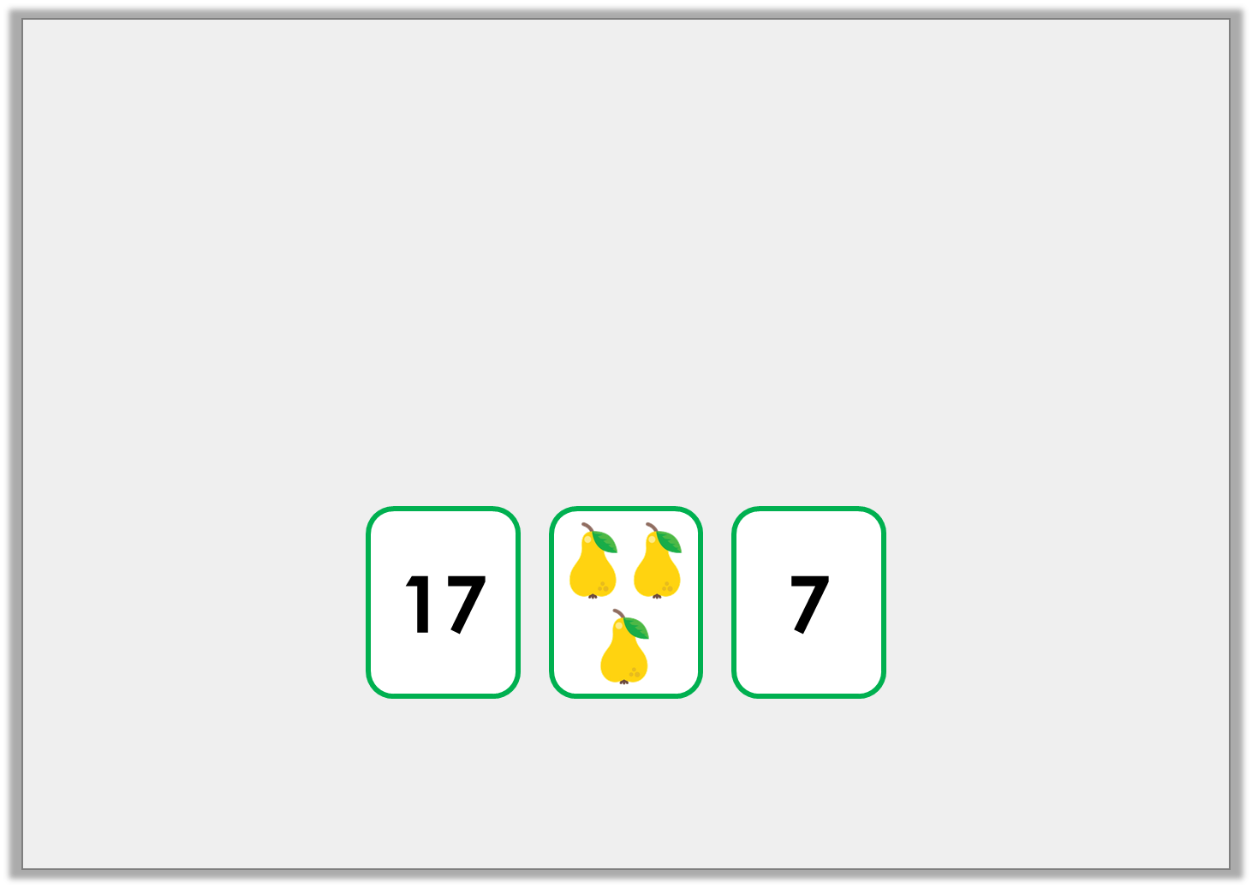
Problem Solving 2
Choose the correct cards to complete the number sentence.
 | – |  | = | 14
© Classroom Secrets Limited 2018

Slide 8
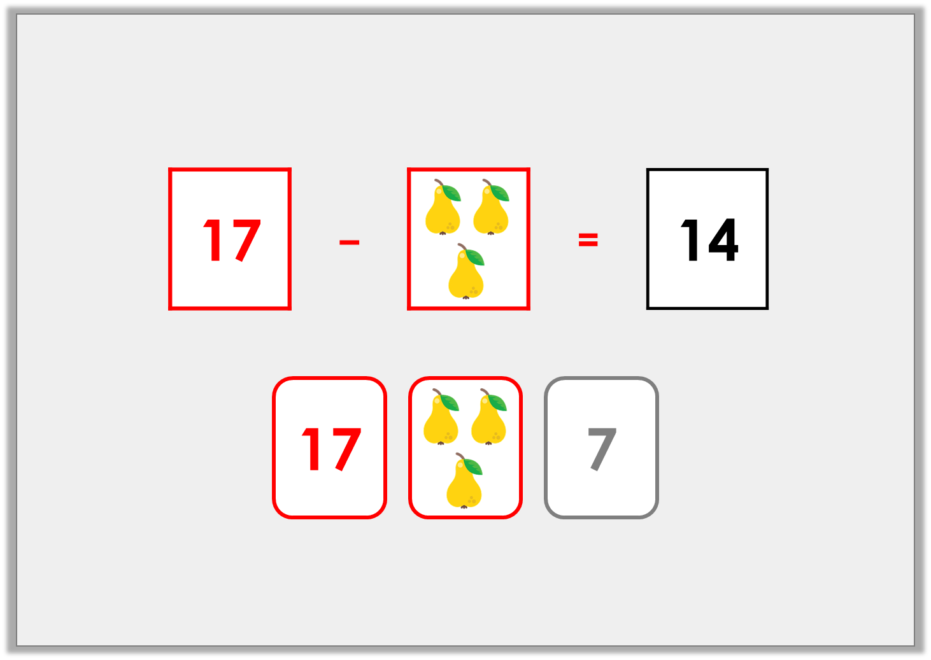
Problem Solving 2
Choose the correct cards to complete the number sentence.
© Classroom Secrets Limited 2018

