Slide 1
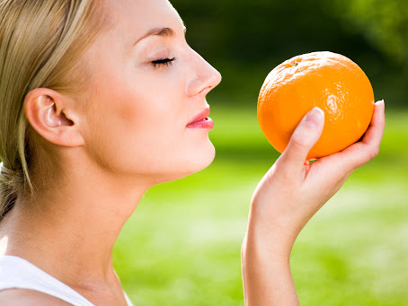
The Sense of Smell

Slide 2
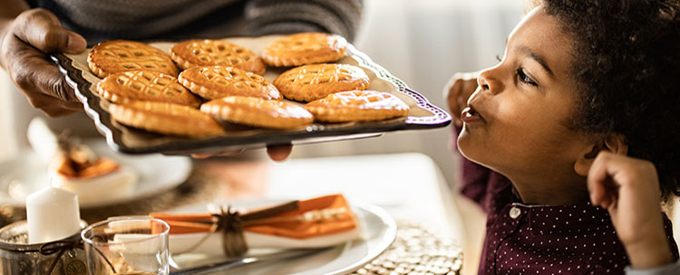
One of our strongest senses is our sense of smell.
Our sense of smell helps us decide what we would like to eat.

Slide 3
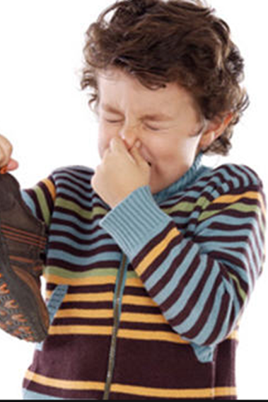
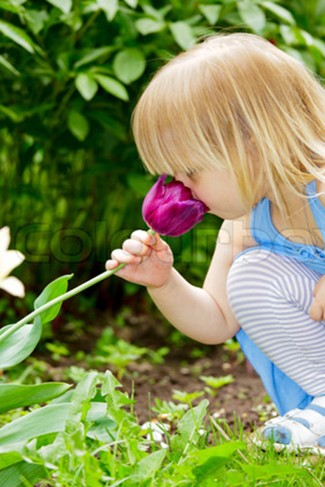
Some things smell nice and some things don’t!

Slide 4
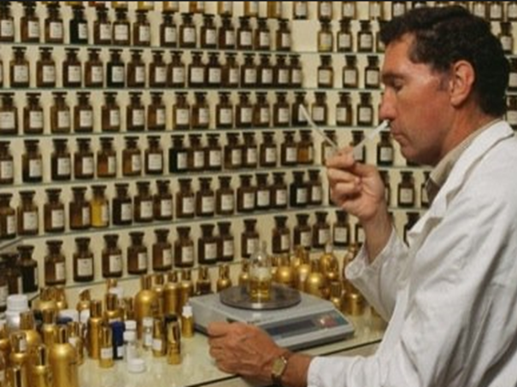
Some peoples jobs involve smell. This man makes perfume.

Slide 5
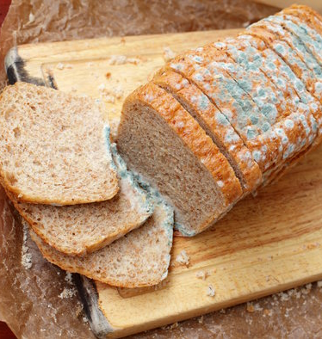
Our sense of smell can keep us safe.
Food that has gone off will smell bad which tells us not to eat it.

Slide 6
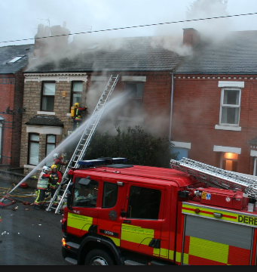
We can smell smoke when something is burning.

