Slide 1
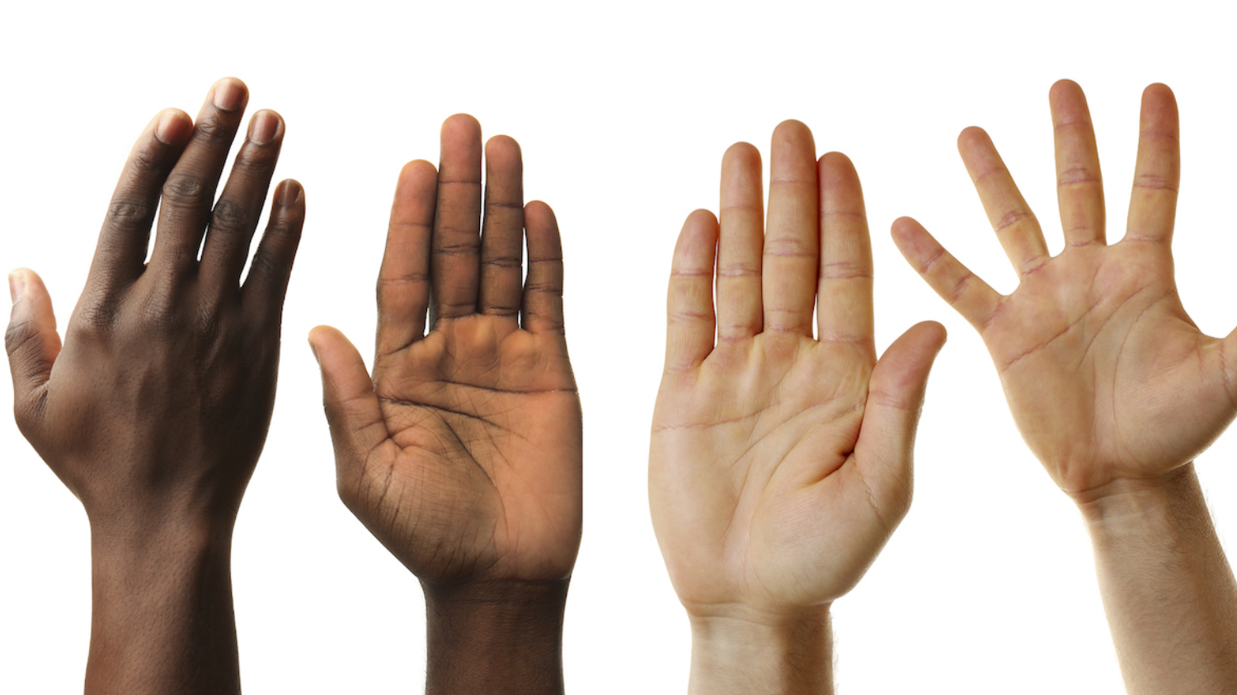
Sense of Touch
Can you use your WOW words to describe what the objects would be like to touch?

Slide 2


Slide 3
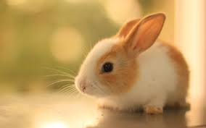

Slide 4


Slide 5
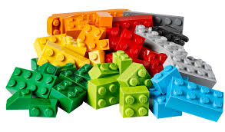

Slide 6
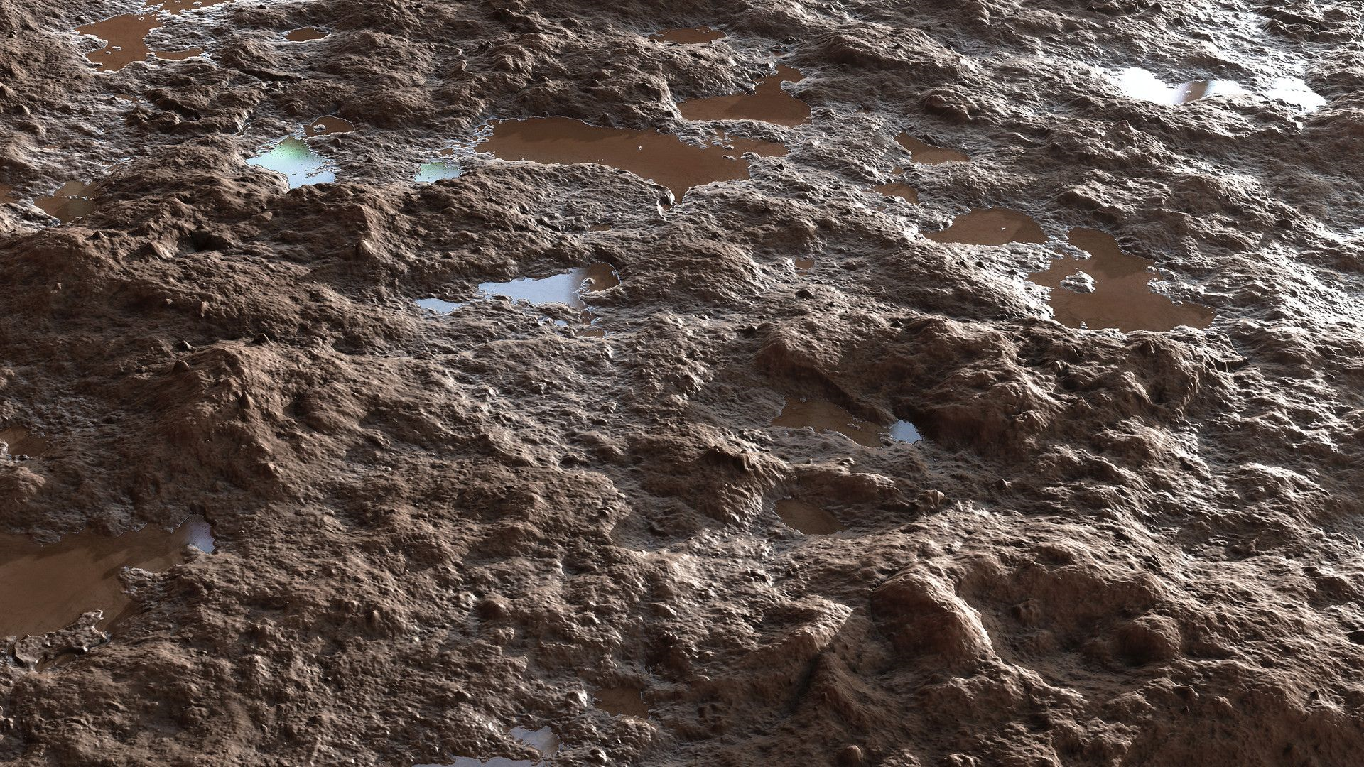

Slide 7


Slide 8
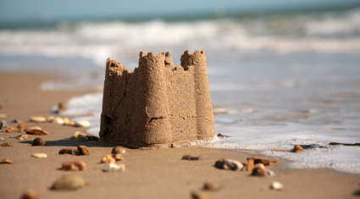

Slide 9


