Slide 1


Year 1 – Spring Block 1 – Addition and Subtraction
Step 1: Add by Counting On
© Classroom Secrets Limited 2018

Slide 2
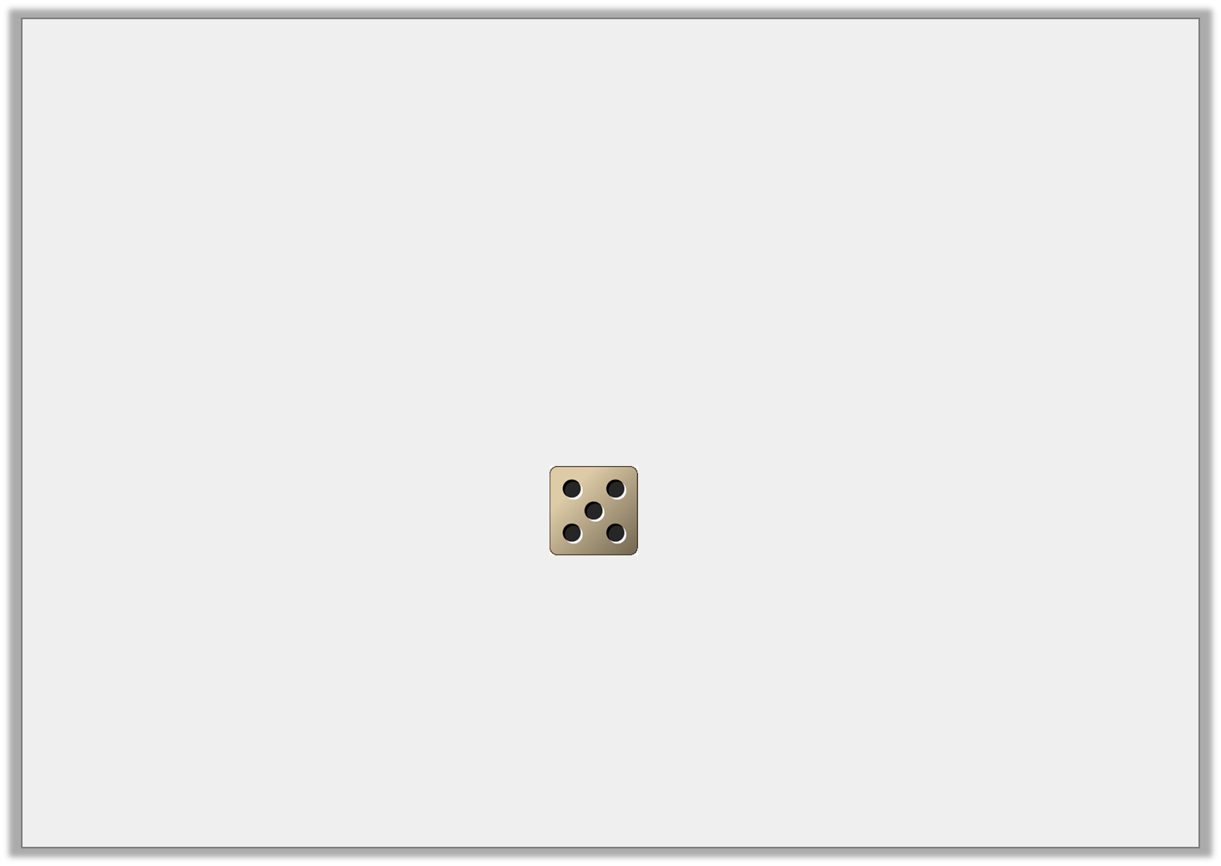
Problem Solving 1
Freddy chooses a number card.
Then he rolls a dice and counts on the number he rolls.
What could his score be? Find all the possible answers.
5
7
6
© Classroom Secrets Limited 2018

Slide 3
Problem Solving 1
Freddy chooses a number card.
Then he rolls a dice and counts on the number he rolls.
What could his score be? Find all the possible answers.
5 + 5 = 10 7 + 5 = 12 6 + 5 = 11
5
7
6
© Classroom Secrets Limited 2018

Slide 4
Reasoning 1
Count on to find the odd one out.
Explain your answer.
A. | ?
 | 7
B. | ?
 | 8
C. | ?
 |  | 11
© Classroom Secrets Limited 2018

Slide 5
Reasoning 1
Count on to find the odd one out.
Explain your answer.
C is the odd one out because…
A. | ?
 | 7
B. | ?
 | 8
C. | ?
 |  | 11
© Classroom Secrets Limited 2018

Slide 6
Reasoning 1
Count on to find the odd one out.
Explain your answer.
C is the odd one out because A and B equal 12 but C equals 14.
A. | 12
 | 7
B. | 12
 | 8
C. | 14
 |  | 11
© Classroom Secrets Limited 2018

Slide 7


Problem Solving 2
Count on 4 from each number.
If the answer is more than 15 colour the box.
8 |  | 15
 | 9
10 |  | 11
© Classroom Secrets Limited 2018

Slide 8
Problem Solving 2
Count on 4 from each number.
If the answer is more than 15 colour the box.
8 |  | 15
 | 9
10 |  | 11
© Classroom Secrets Limited 2018

