Slide 1
Autobiographies and Biographies

Slide 2
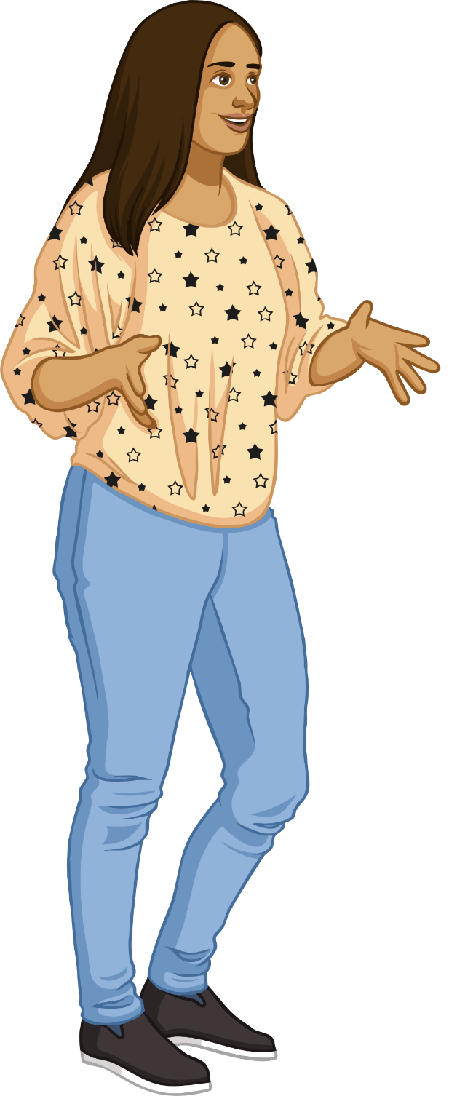

Biography Activity 1
Grab a pencil or pen and get ready to make some notes based on a member of your family.
You are going to create a timeline of events in chronological order based on events that were important in their lives. Try and get 3-5 really significant/stand out moments of your subject’s life.
Points to possibly find out:
Where and when they were born
Their family/siblings
Significant events in their life and feelings about these events (e.g. starting school, joining clubs, moving house, achievements etc.)

Slide 3
Timeline example:
Princess Diana
1st July 1961- Diana Frances Spencer was born.
1970- Diana went to boarding school.
November 1977- Diana met Prince Charles
July 1980- Diana and Prince Charles became a couple
24th February 1981- Diana and Prince Charles announced engagement.
29th July 1981- Diana and Prince Charles get married in St. Paul’s Cathedral
21st June 1982- Diana gives birth to Prince William
24th September 1984- Diana gives birth to Prince Harry
28th August 1996- Prince Charles and Diana are divorced
31st August 1997- Diana dies in a car crash in Paris.

