Slide 1
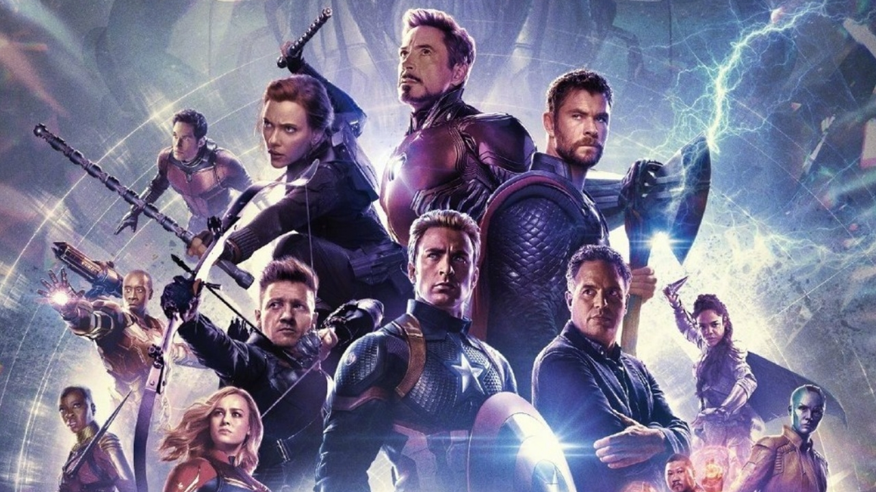
Superheroes.

Slide 2
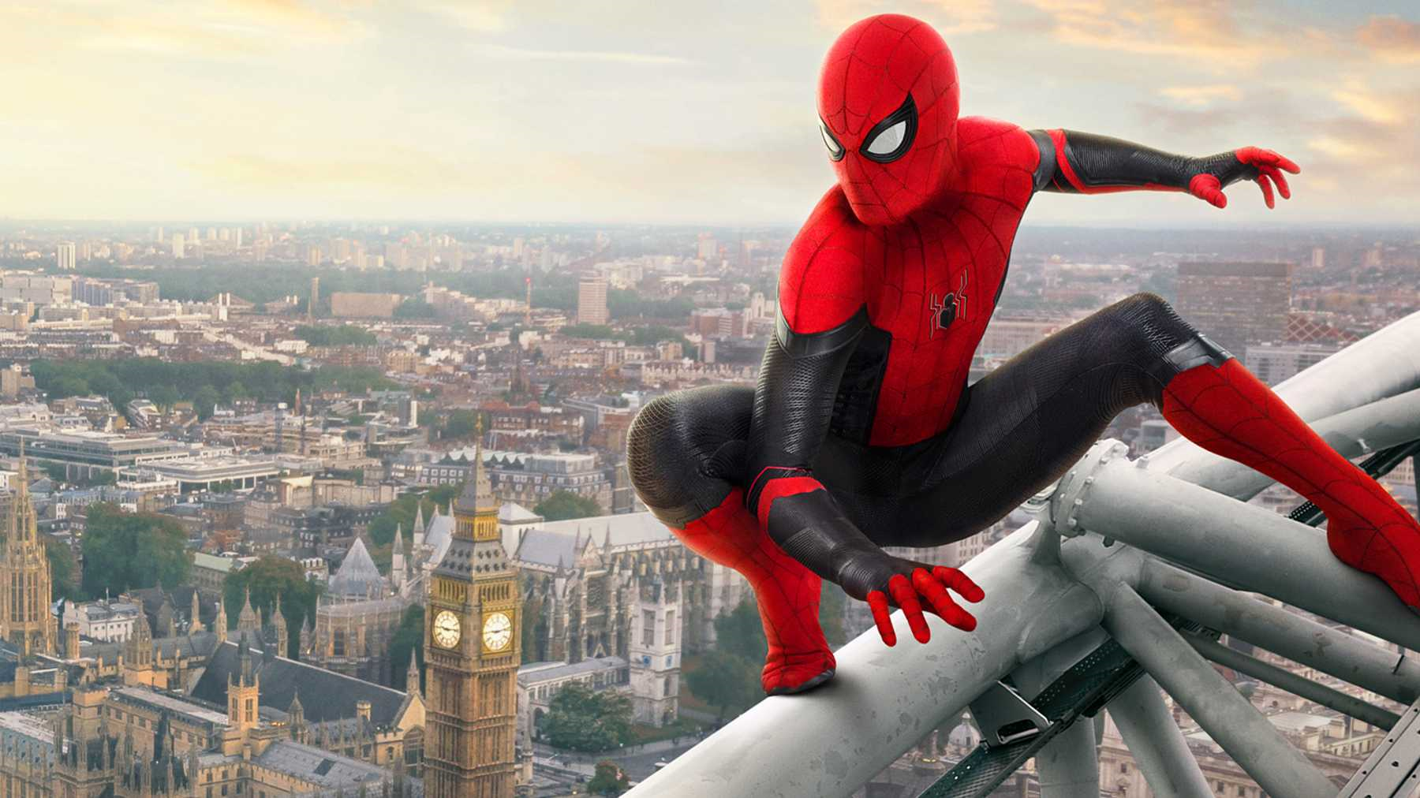
This Superhero loves to spin webs.

Slide 3
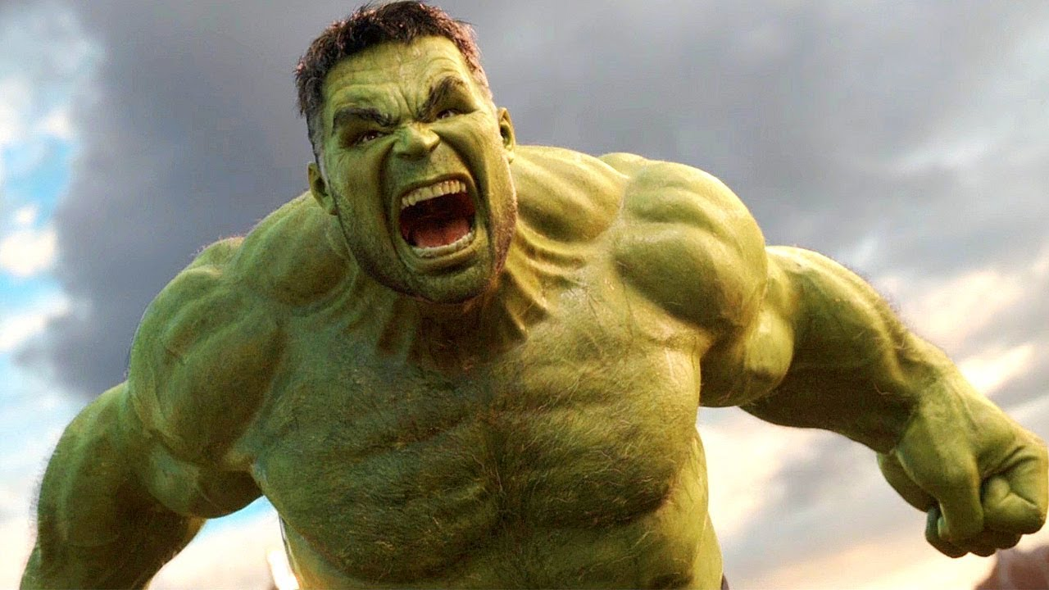
When he’s angry he’s green and super strong.

Slide 4
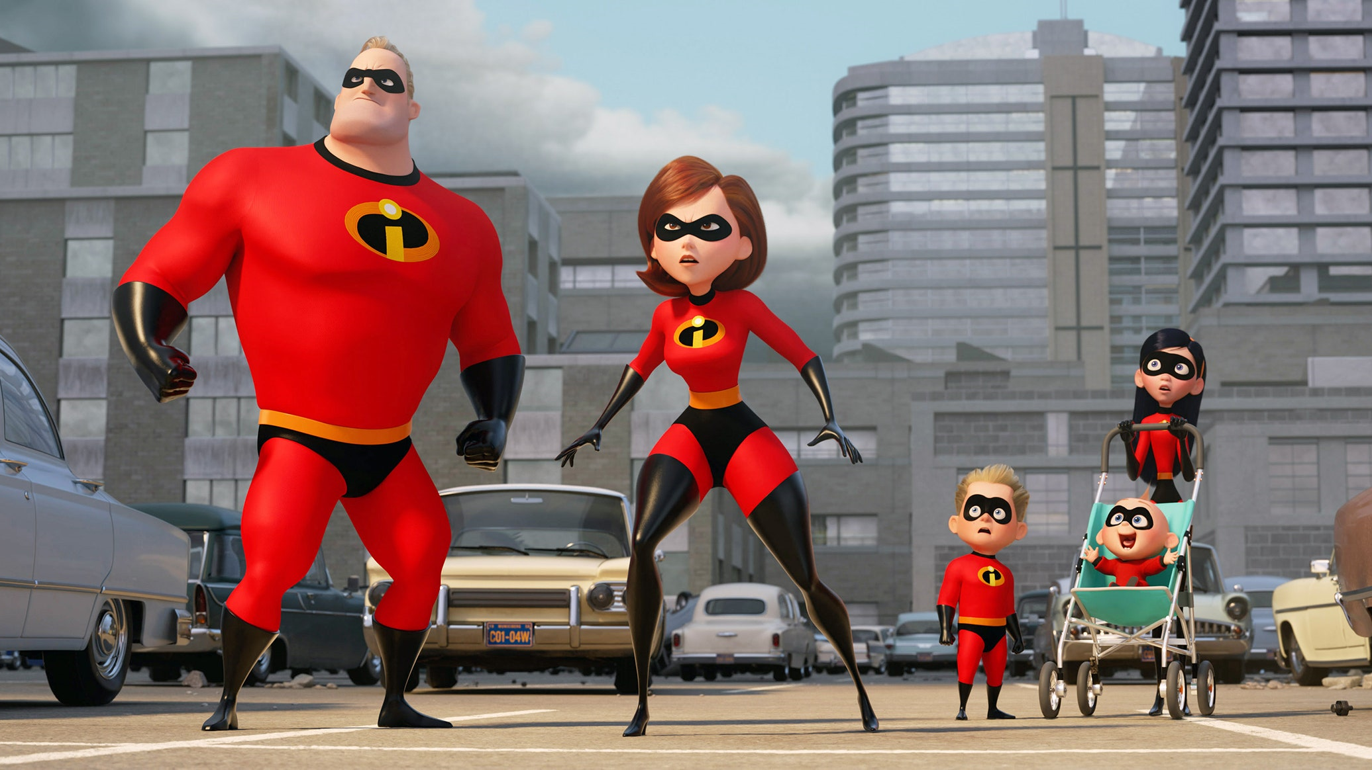
This is a whole family of superheroes.

Slide 5
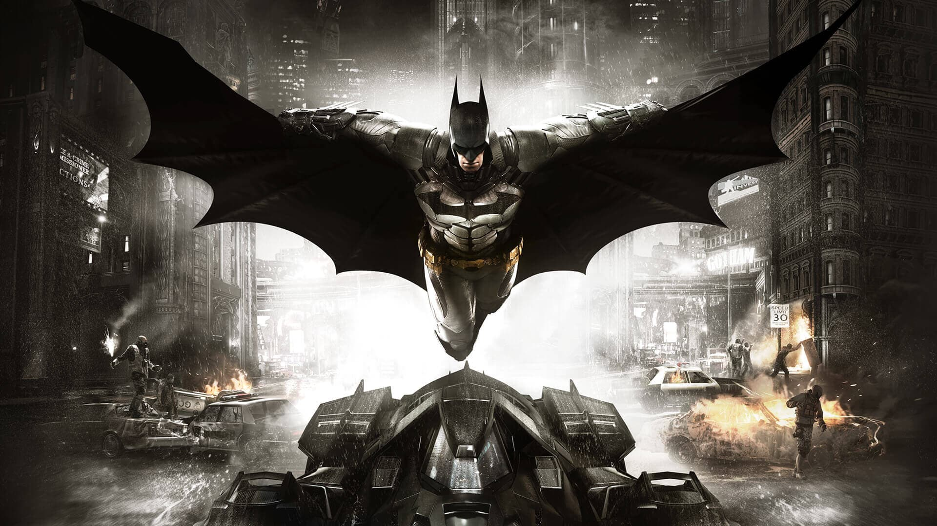
He likes black and has lots of gadgets.

Slide 6
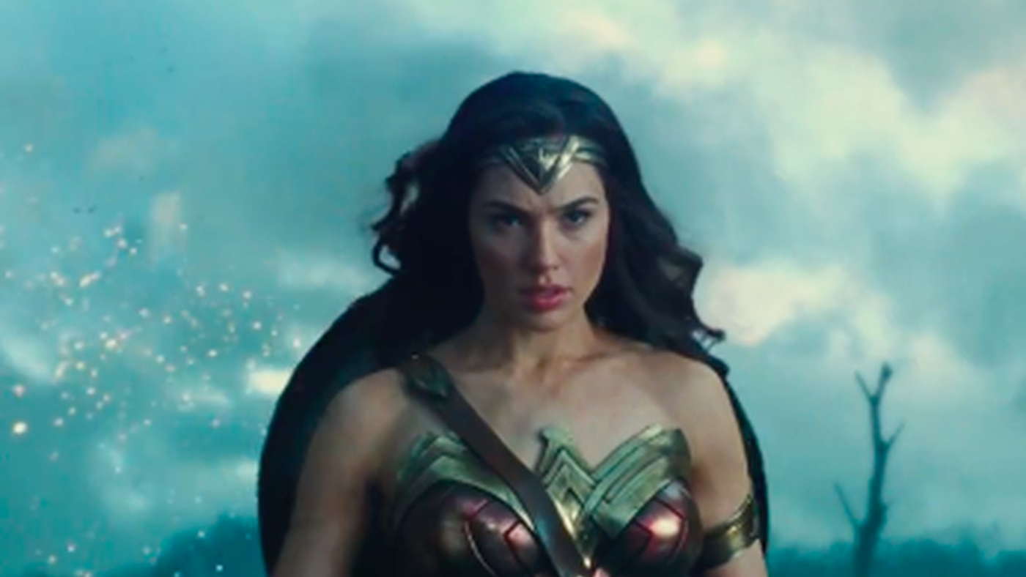
She has super strength and fighting skills.

Slide 7
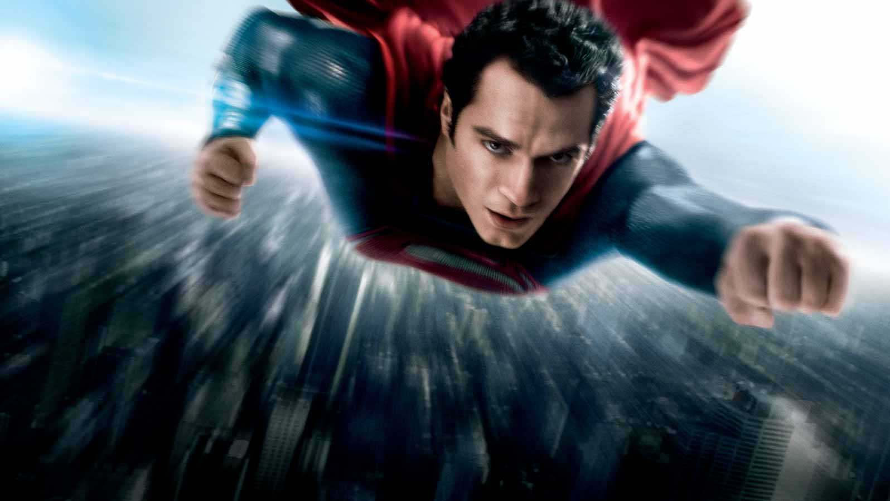
This superhero can fly but must steer clear of kryptonite.

Slide 8
Can you think of any more?

