Slide 1


Year 1 – Spring Block 1 – Addition and Subtraction
Step 1: Add by Counting On
© Classroom Secrets Limited 2018

Slide 2
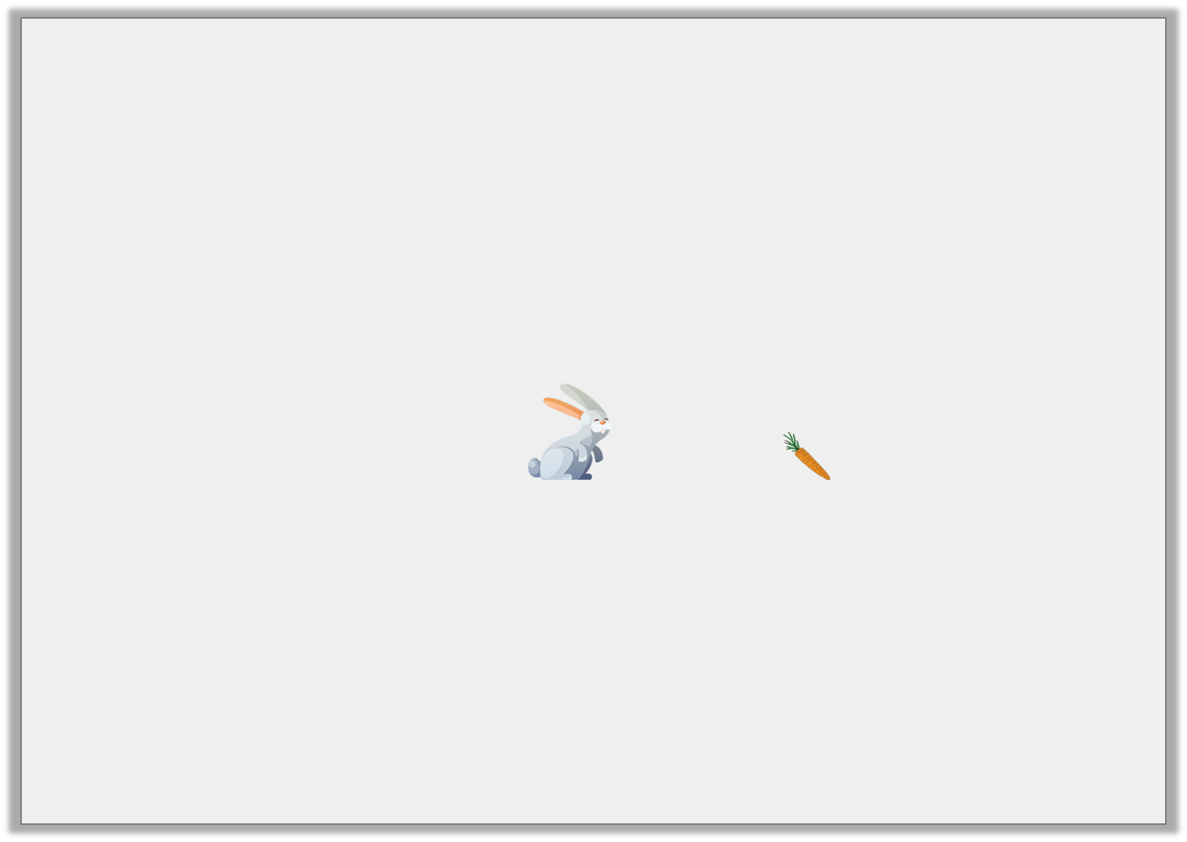
Introduction
The rabbit is jumping to get the carrots.
He has done 7 jumps so far.
How many more jumps does the rabbit need to do?
0 | 1 | 2 | 3 | 4 | 5 | 6 | 7 | 8 | 9 | 10 | 11 | 12 | 13 | 14 | 15
© Classroom Secrets Limited 2018

Slide 3
Introduction
The rabbit is jumping to get the carrots.
He has done 7 jumps so far.
How many more jumps does the rabbit need to do?
4
0 | 1 | 2 | 3 | 4 | 5 | 6 | 7 | 8 | 9 | 10 | 11 | 12 | 13 | 14 | 15
© Classroom Secrets Limited 2018

Slide 4
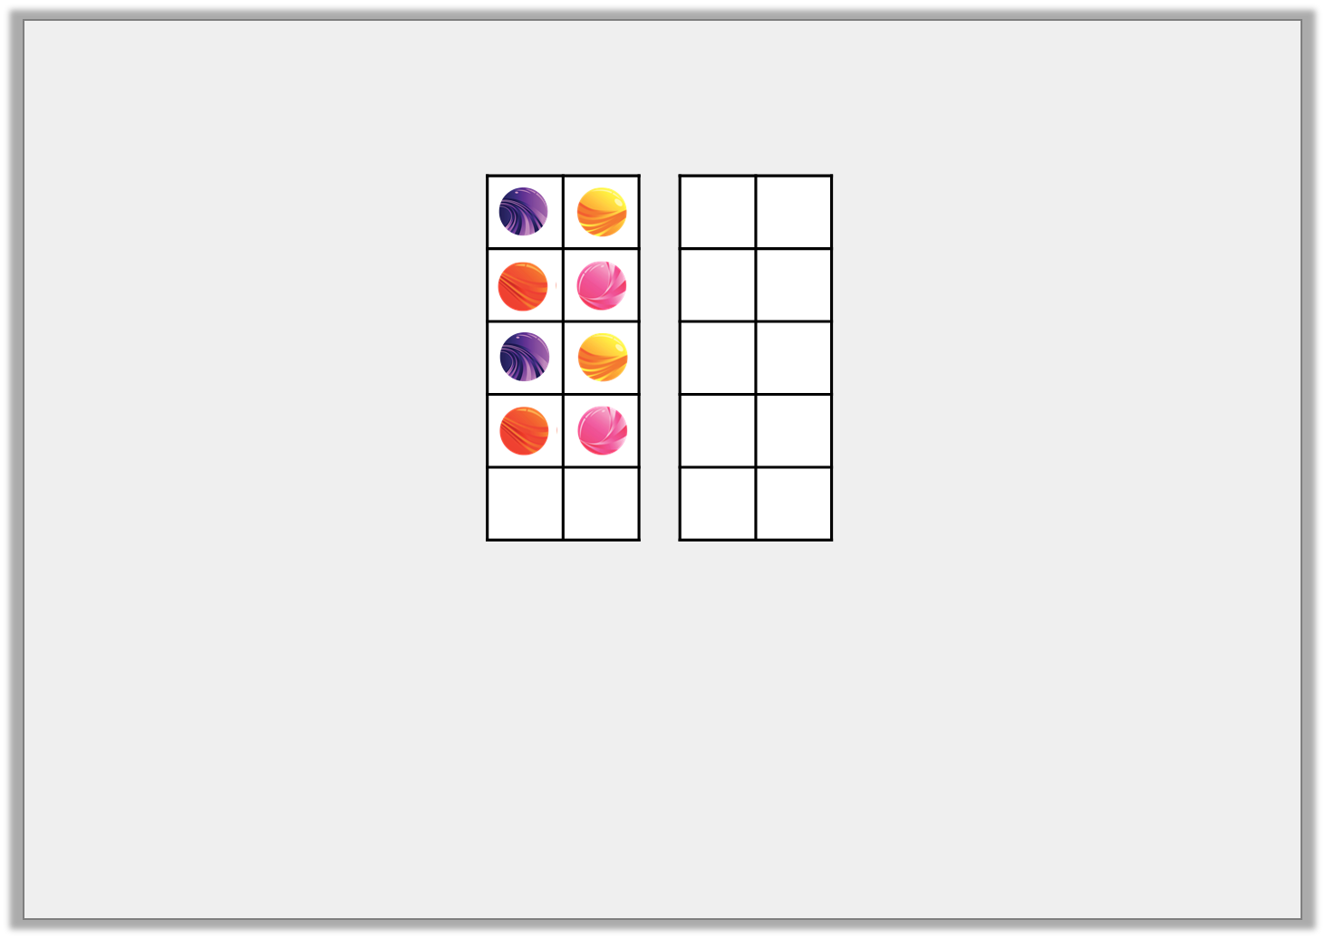
Varied Fluency 1
True or false?
Ted has 8 marbles. He wins 6 more. Now he has 14 marbles.
© Classroom Secrets Limited 2018

Slide 5
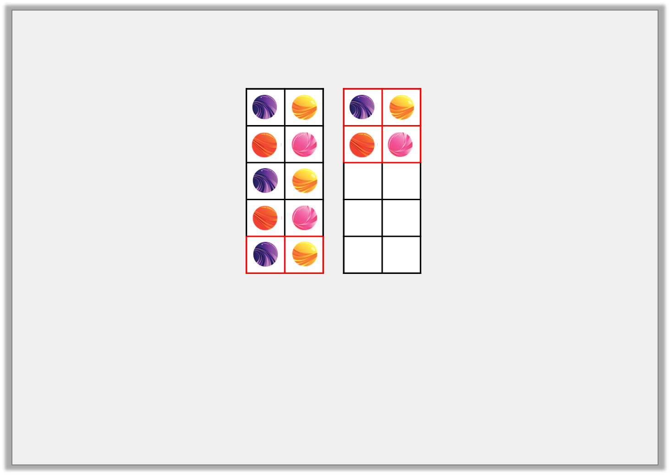
Varied Fluency 1
True or false?
True
Ted has 8 marbles. He wins 6 more. Now he has 14 marbles.
© Classroom Secrets Limited 2018

Slide 6
Varied Fluency 2
Use the number line to complete the number sentence.
15 | + | 4 | =
10 | 11 | 12 | 13 | 14 | 15 | 16 | 17 | 18 | 19 | 20
© Classroom Secrets Limited 2018

Slide 7
Varied Fluency 2
Use the number line to complete the number sentence.
15 | + | 4 | = | 19
10 | 11 | 12 | 13 | 14 | 15 | 16 | 17 | 18 | 19 | 20
© Classroom Secrets Limited 2018

Slide 8
Varied Fluency 3
Complete the bar model by counting on.
13 | 5
13 | 1 | 1 | 1 | 1 | 1
© Classroom Secrets Limited 2018

Slide 9
Varied Fluency 3
Complete the bar model by counting on.
18
13 | 5
13 | 1 | 1 | 1 | 1 | 1
© Classroom Secrets Limited 2018

Slide 10
Varied Fluency 4
Circle the number sentence shown on the number line and complete the answer.
0 | 1 | 2 | 3 | 4 | 5 | 6 | 7 | 8 | 9 | 10 | 11 | 12 | 13 | 14 | 15 | 16 | 17 | 18 | 19 | 20
7 + 4 = |  | 7 + 5 =
11 + 7 = |  | 0 + 7 =
© Classroom Secrets Limited 2018

Slide 11
Varied Fluency 4
Circle the number sentence shown on the number line and complete the answer.
0 | 1 | 2 | 3 | 4 | 5 | 6 | 7 | 8 | 9 | 10 | 11 | 12 | 13 | 14 | 15 | 16 | 17 | 18 | 19 | 20
12
7 + 4 = |  | 7 + 5 =
11 + 7 = |  | 0 + 7 =
© Classroom Secrets Limited 2018

