Slide 2


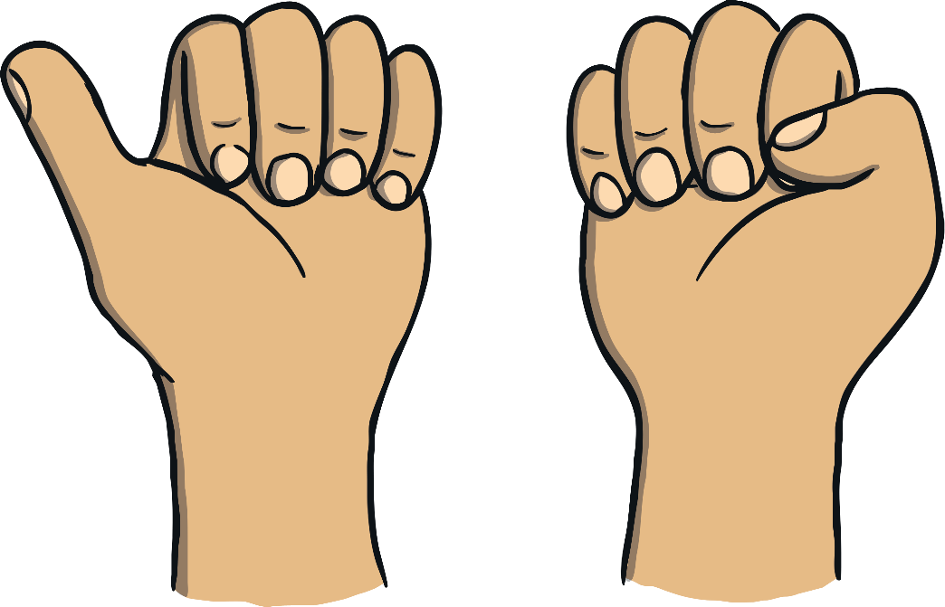

10 sleepy fingers are curled up so small,
All getting ready to stand up tall!
Number one says: “Let’s have some fun!”
9 are sleeping and awake is 1.
1

Slide 3
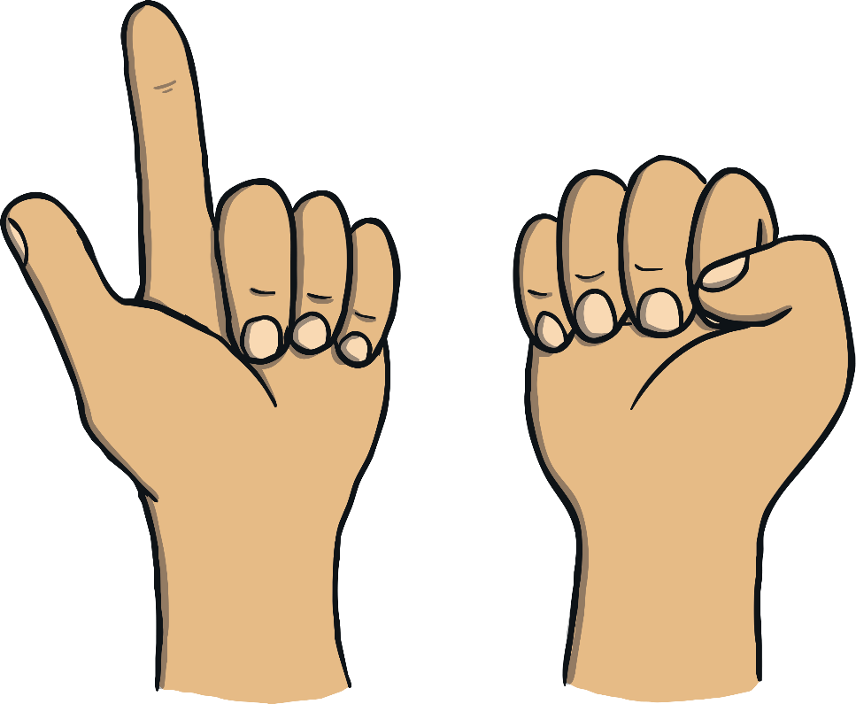
9 sleepy fingers are curled up so small,
All getting ready to stand up tall!
One of them says, “I’ll stand with you”,
8 are sleeping and awake are 2.
2

Slide 4
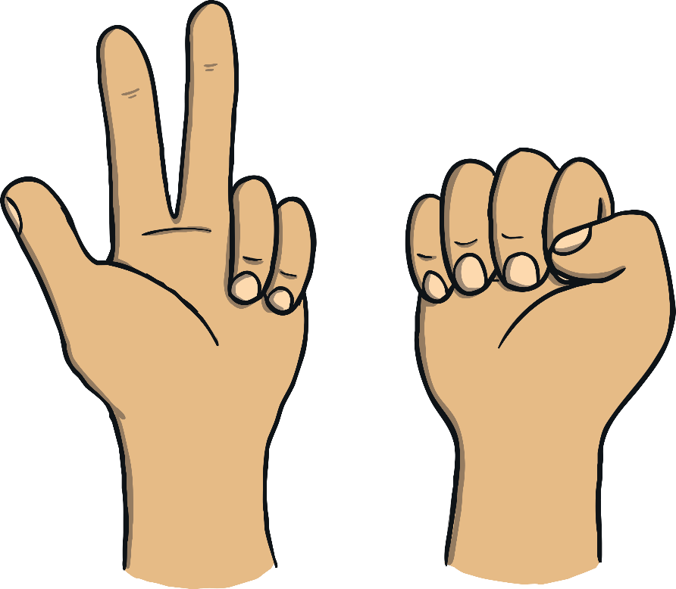
8 sleepy fingers curled up so small,
All getting ready to stand up tall!
One of them says, “Come play with me”,
7 are sleeping and awake are 3.
3

Slide 5
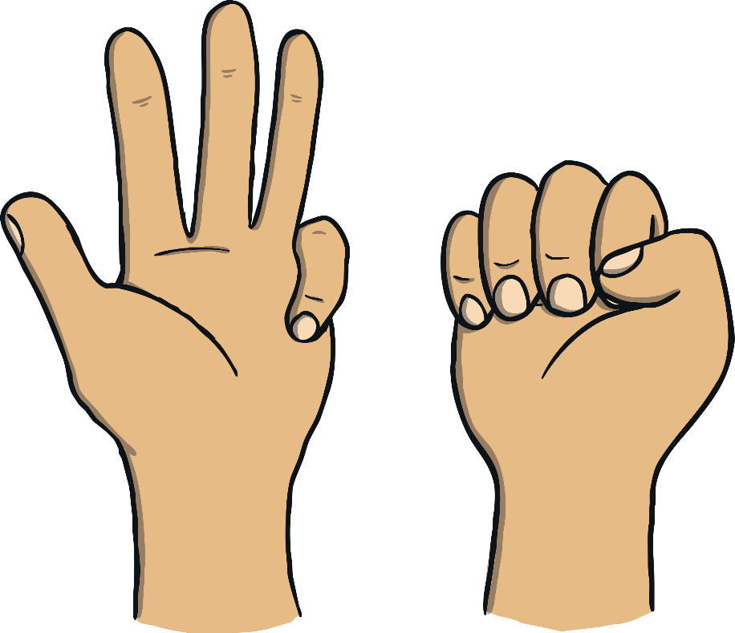
7 sleepy fingers are curled up so small,
All getting ready to stand up tall!
One of them says, “No time to snore!”,
6 are sleeping and awake are 4.
4

Slide 6
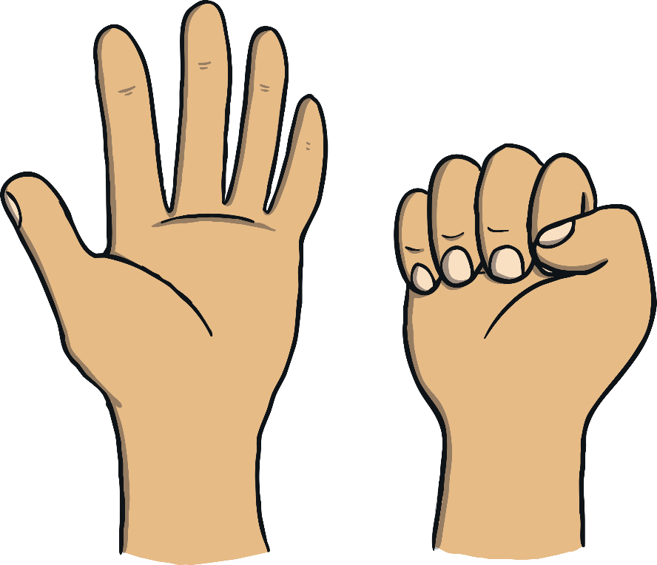
6 sleepy fingers are curled up so small,
All getting ready to stand up tall!
One of them says, “I feel alive!”,
5 are sleeping and awake are 5.
5

Slide 7

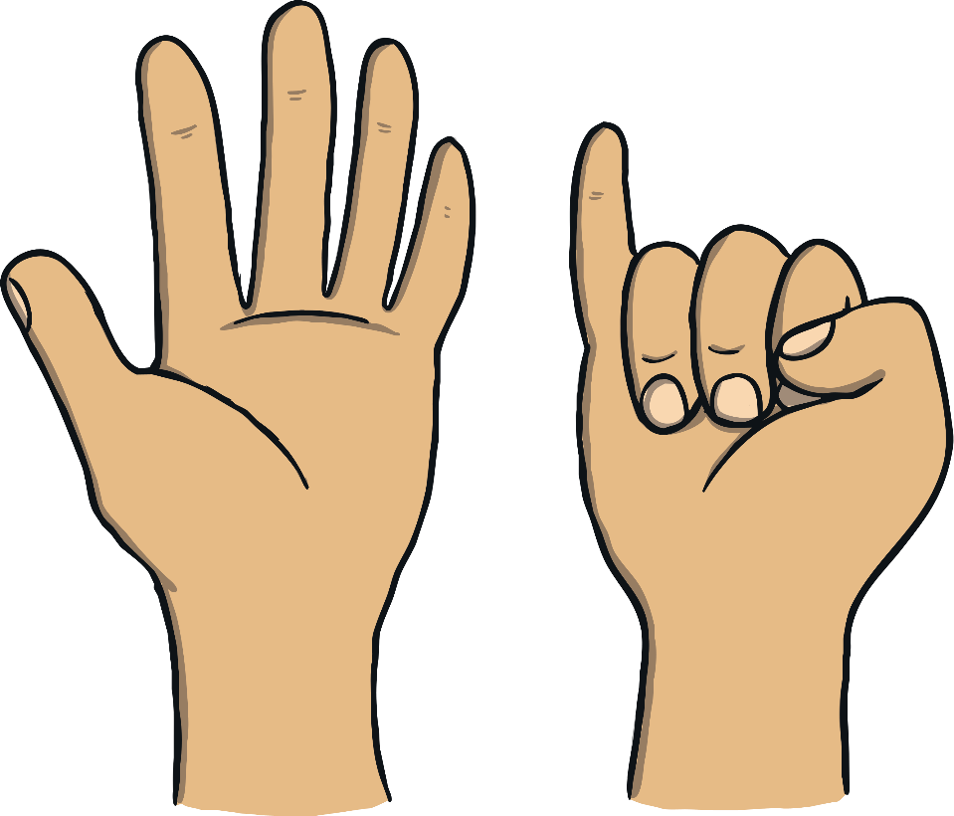
5 sleepy fingers curled up so small,
All getting ready to stand up tall!
One of them says, “It’s time for tricks!”,
4 are sleeping and awake are 6.
6

Slide 8

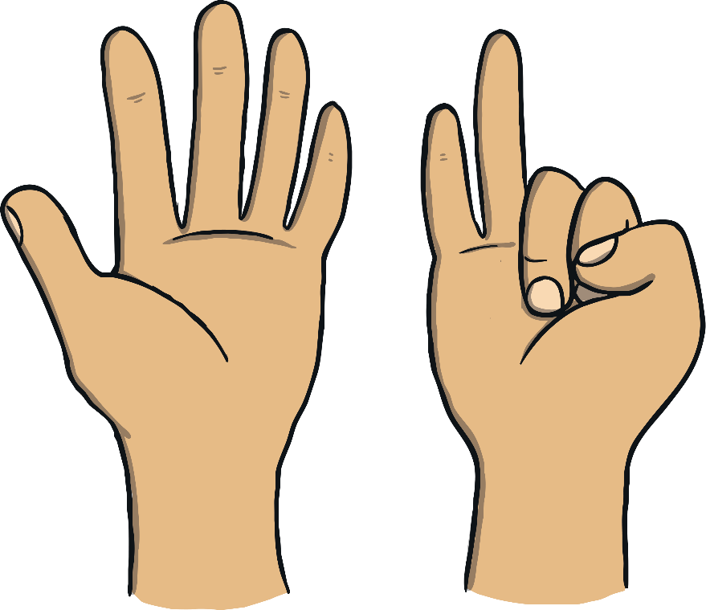
4 sleepy fingers are curled up so small,
All getting ready to stand up tall!
One of them says, “I’m number 7!”,
3 are sleeping and awake are 7.
7

Slide 9
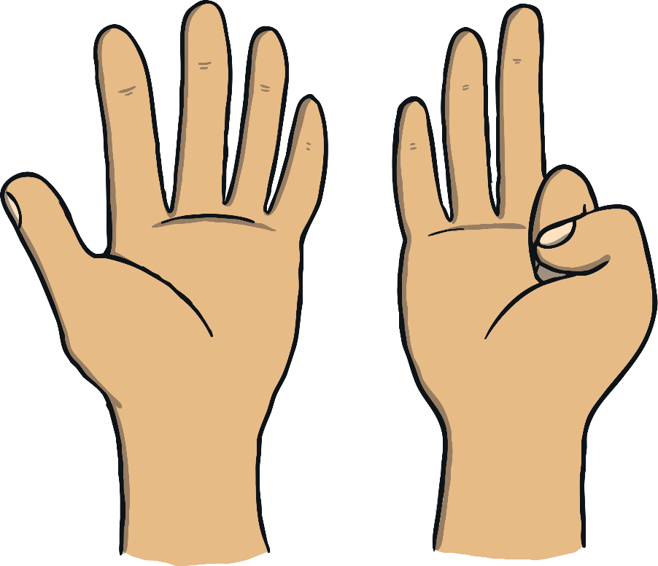

3 sleepy fingers are curled up so small,
All getting ready to stand up tall!
One of them says, “I’m feeling great!”,
2 are sleeping and awake are 8.
8

Slide 10
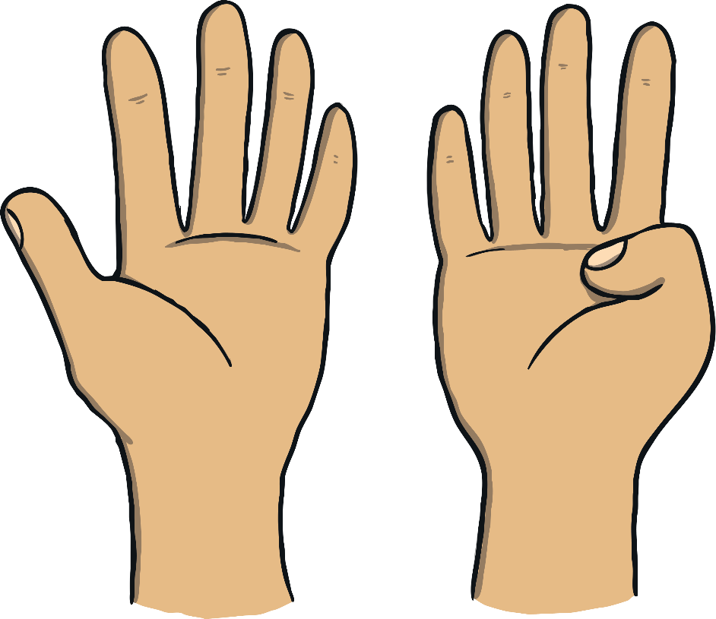

2 sleepy fingers are curled up so small,
All getting ready to stand up tall!
One of them says, “I’ll join the line”,
1 is sleeping and awake are 9.
9

Slide 11
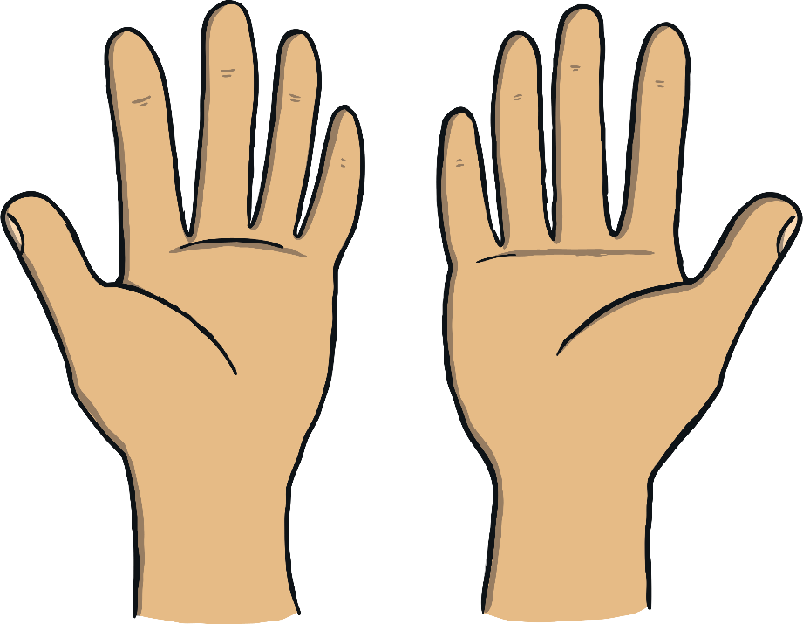

1 sleepy finger is curled up so small,
All getting ready to stand up tall!
One of them says, “I’m awake again!”,
None sleeping and awake are 10.
10

