Slide 2

Instructions
Hello everyone!
My name is Chef Maria.
My favourite food to make is fruit salad.
Would you like to help me make some?
Can you help me work out the number of ingredients in each bowl?

Slide 3
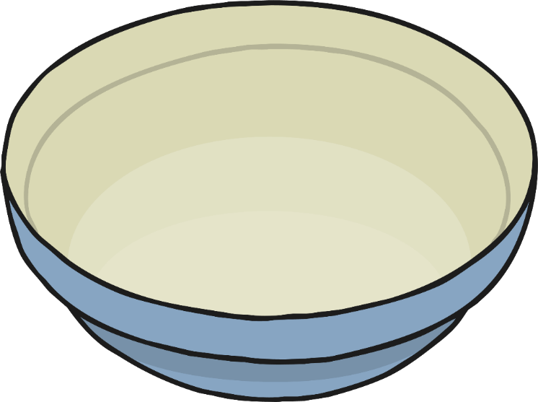


I don’t have any cherries today. How many apple slices are in the bowl?
Ingredients
0 cherries
5 slices of apple
Click me to see the
number sentence.
0 add 5 makes 5

Slide 4




Can you put the ingredients in to the bowl?
How many are there altogether?
Ingredients
1 slice of strawberry
4 slices of banana
Click me to see the
number sentence.
1 add 4 makes 5

Slide 5




I think 3 add 2 makes 4. Am I correct? Why? Why not?
Ingredients
2 slices of banana
3 pieces of satsuma
Click me to see the
number sentence.
2 add 3 makes 5

Slide 6




Do I need to count the grapes first? Does the answer change if I count the strawberries first?
Ingredients
3 pieces of grape
2 slices of strawberry
Click me to see the
number sentence.
3 add 2 makes 5

Slide 7




I wonder what would happen if I changed the recipe and used 4 slices of apple and 1 slice of strawberry. Would I use the same number of fruit pieces?
Ingredients
4 slices of strawberry
1 slice of apple
Click me to see the
number sentence.
4 add 1 makes 5

Slide 8

Oh no! I’ve run out of strawberries! Can you say a number bond sentence about this fruit salad?
Ingredients
5 pieces of satsuma
0 slices of strawberry
Click me to see the
number sentence.
5 add 0 makes 5

Slide 9
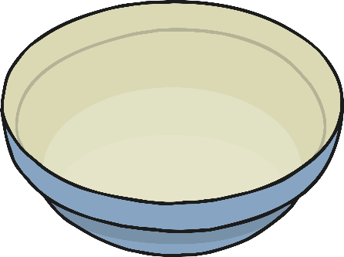





What do you notice about the fruit
salads we have made?
What is the same? What is different?
5 + 0
1 + 4
All of the bowls of fruit salad have 5 pieces of fruit.
2 + 3
3 + 2
Click me to see what we found out.
4 + 1
5 + 0

Slide 10
Which fruit salad is your favourite? Can you tell a friend a number bond sentence about your favourite fruit salad?
5 + 0
1 + 4
+
= 5
2 + 3
3 + 2
Click me to see the
number sentence.
4 + 1
5 + 0

Slide 11
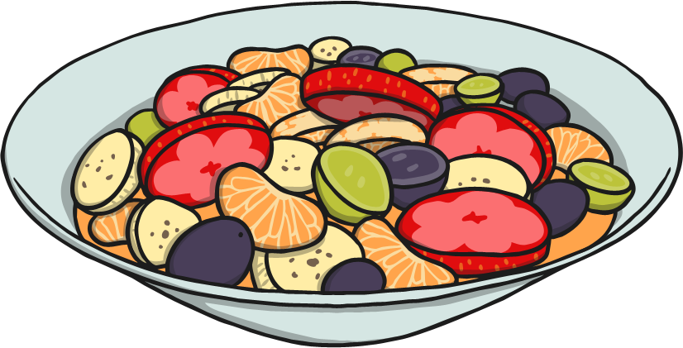
Thank you for helping to work out
how many pieces of fruit are in each of
my fruit salads.
start again

