Slide 1

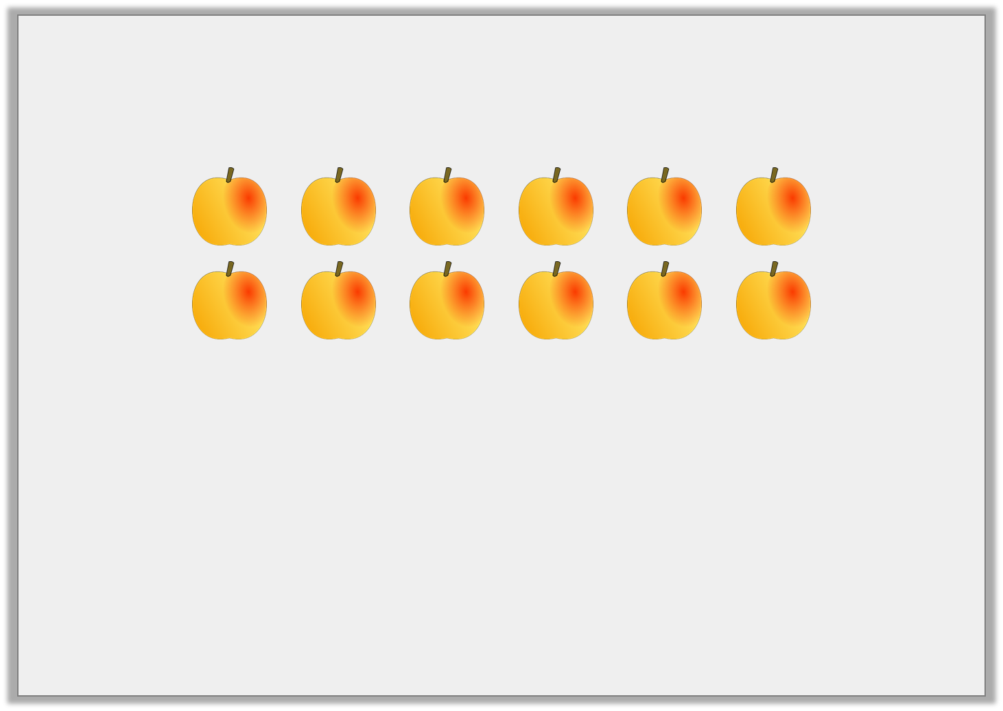

Varied Fluency 2
Find one quarter of the peaches below? Circle the correct answer.
4 |  | 1 |  | 2 |  | 3
Y2
© Classroom Secrets Limited 2019

Slide 2
Varied Fluency 2
Find one quarter of the peaches below? Circle the correct answer.
4 |  | 1 |  | 2 |  | 3
Y2
© Classroom Secrets Limited 2019

Slide 3
Varied Fluency 3
Colour a quarter of the shape and then complete the sentence.
The shape has |  | equal parts.
of |  | is
1
4
Y2
© Classroom Secrets Limited 2019

Slide 4
Reasoning 1
Lydia thinks she has coloured in one quarter of the cubes. Is she right?
How do you know?
Y1
© Classroom Secrets Limited 2018

Slide 5
Reasoning 1
Lydia thinks she has coloured in one quarter of the cubes. Is she right?
How do you know?
Lydia is wrong because…
Y1
© Classroom Secrets Limited 2018

Slide 6
Reasoning 1
Lydia thinks she has coloured in one quarter of the cubes. Is she right?
How do you know?
Lydia is wrong because there are 12 equal parts and one quarter of 12 is 3.
She needs to colour 3 parts, not 4.
Y1
© Classroom Secrets Limited 2018

Slide 7
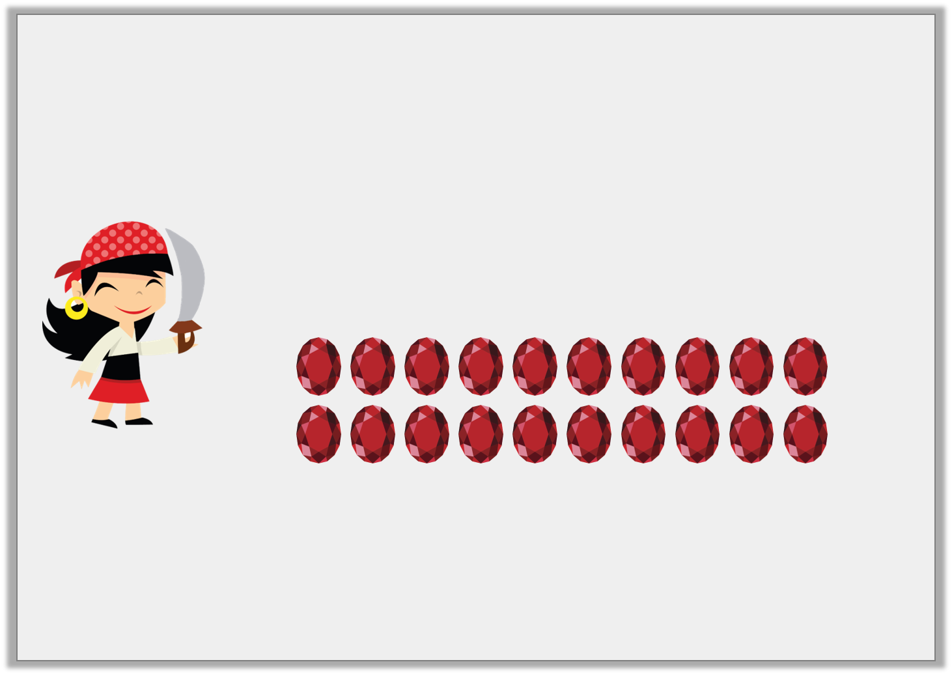
Reasoning 2
Pirate Polly wants to put one quarter of her gems in her treasure chest.
What mistake is Pirate Polly making?
I’m going to put 4 of these gems in my treasure chest.
Y1
© Classroom Secrets Limited 2018

Slide 8
Reasoning 2
Pirate Polly wants to put one quarter of her gems in her treasure chest.
What mistake is Pirate Polly making?
Polly has confused quarters as…
I’m going to put 4 of these gems in my treasure chest.
Y1
© Classroom Secrets Limited 2018

Slide 9
Reasoning 2
Pirate Polly wants to put one quarter of her gems in her treasure chest.
What mistake is Pirate Polly making?
Polly has confused quarters as always being 4 because there are 4 parts, but she has got 20 gems.
A quarter of 20 is 5.
I’m going to put 4 of these gems in my treasure chest.
Y1
© Classroom Secrets Limited 2018

Slide 10
Problem Solving 1
How many different ways can you shade one quarter of the shapes?
Y1
© Classroom Secrets Limited 2018

Slide 11
Problem Solving 1
How many different ways can you shade one quarter of the shapes?
5 parts need to be shaded, e.g.
Y1
© Classroom Secrets Limited 2018

