Slide 1

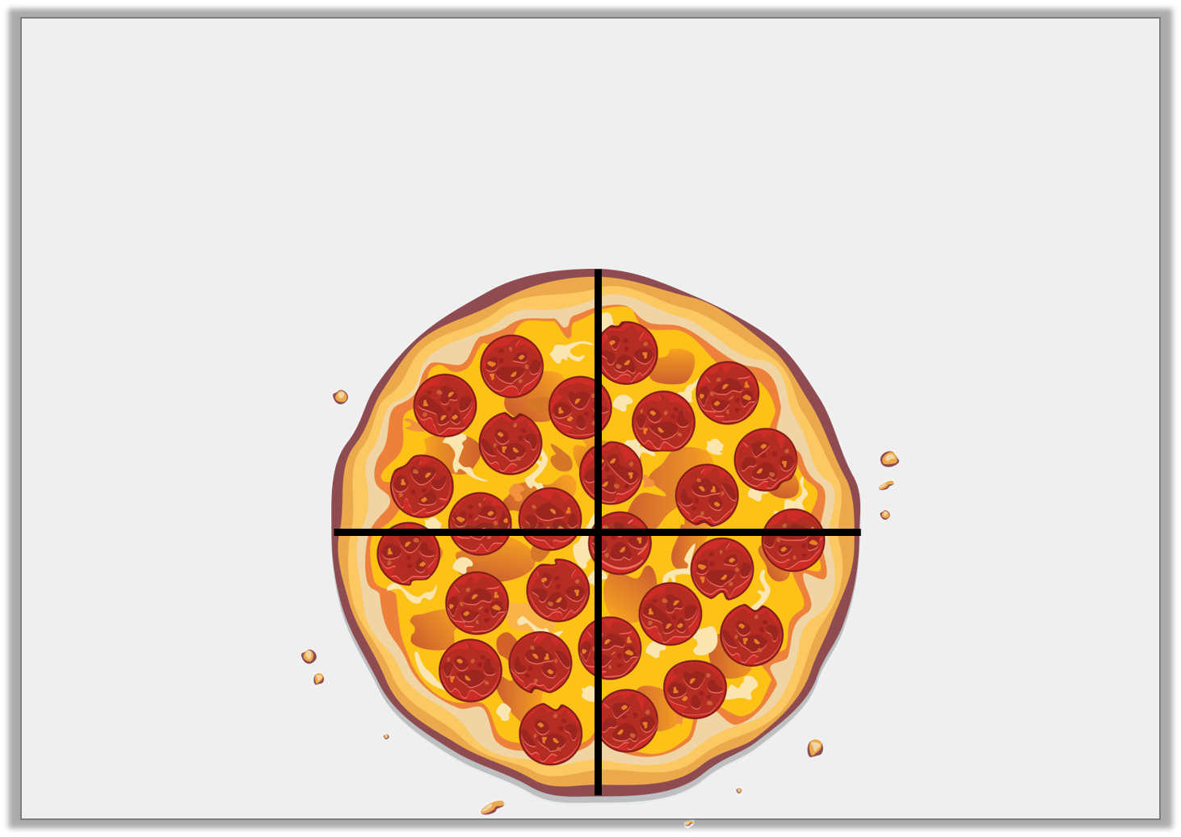

Introduction
How is the pizza split equally?
How is the pizza not split equally?
Y1
© Classroom Secrets Limited 2018

Slide 2
Introduction
How is the pizza split equally?
The pizza is cut into four equal slices.
How is the pizza not split equally?
The slices don’t have the same number of pepperoni pieces on them.
Y1
© Classroom Secrets Limited 2018

Slide 3
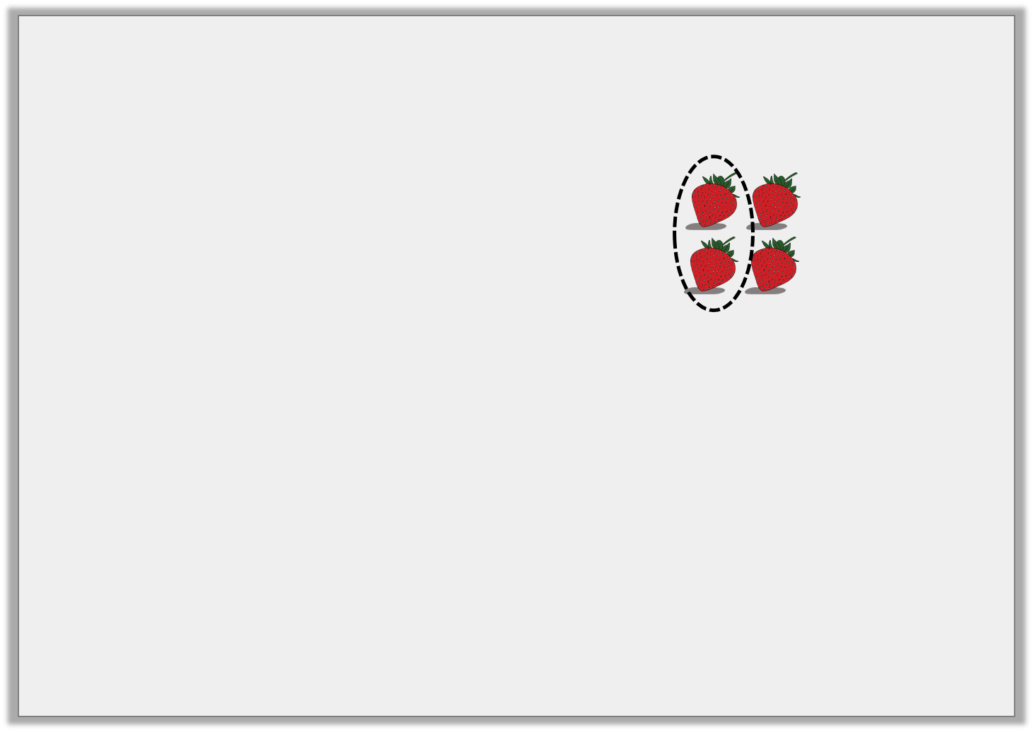

Introduction
Which image is the odd one out?
Y2
© Classroom Secrets Limited 2019

Slide 4
Introduction
Which image is the odd one out?
Y2
© Classroom Secrets Limited 2019

Slide 5
Varied Fluency 1
Complete the statement based on the picture below.
There are ____________ boxes. One quarter of ____________ is ____________ .
Y1
© Classroom Secrets Limited 2018

Slide 6
Varied Fluency 1
Complete the statement based on the picture below.
There are ____________ boxes. One quarter of ____________ is ____________ .
20
20
5
Y1
© Classroom Secrets Limited 2018

Slide 7
Varied Fluency 2
Use the counters to complete the statement.
One quarter of 16 is ________ .
4
Y1
© Classroom Secrets Limited 2018

Slide 8
Varied Fluency 2
Use the counters to complete the statement.
One quarter of 16 is ________ .
4
Y1
© Classroom Secrets Limited 2018

Slide 9
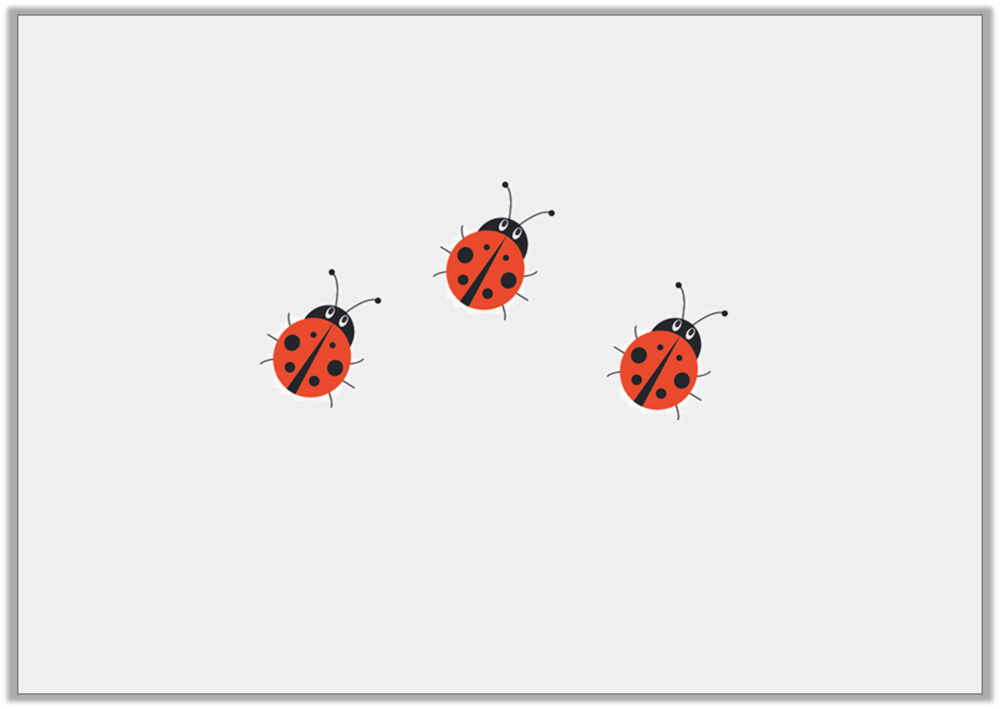
Varied Fluency 3
Here is one quarter.
What is the total?
Y1
© Classroom Secrets Limited 2018

Slide 10
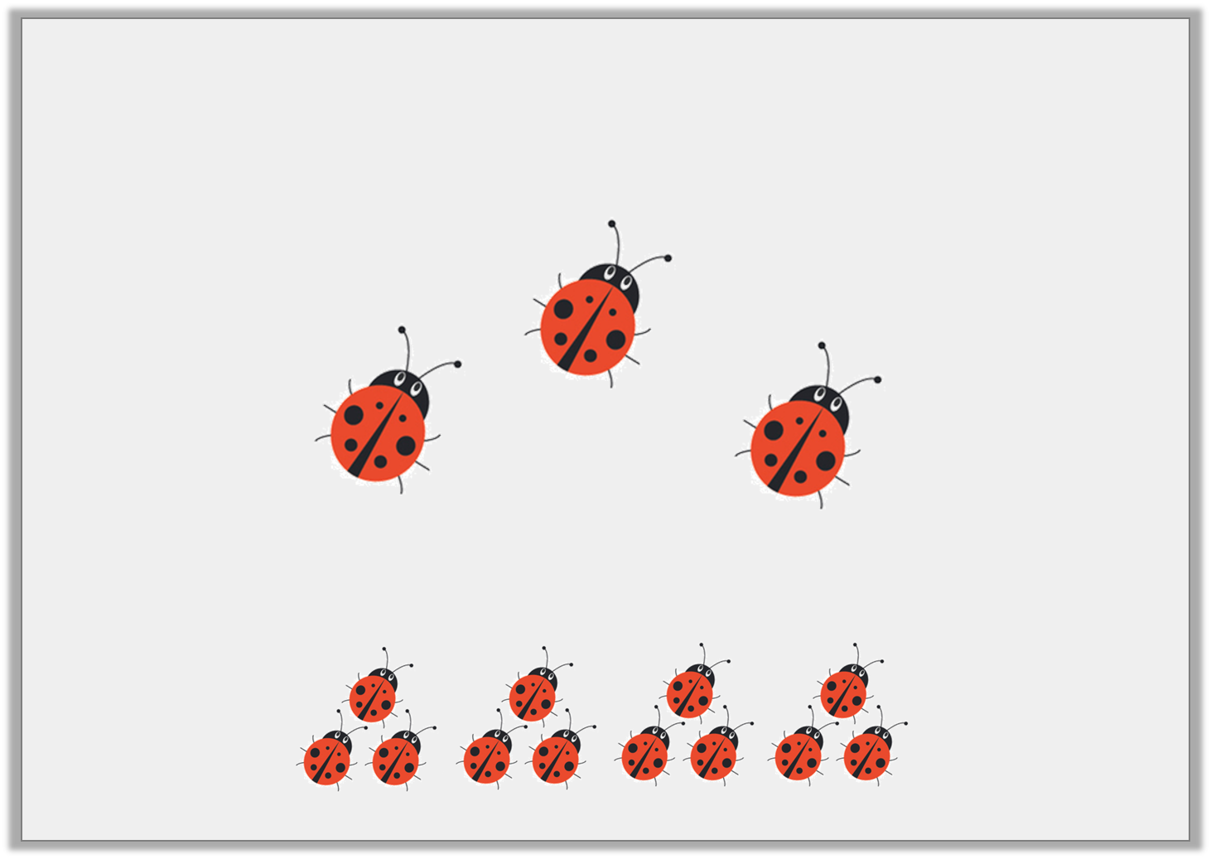
Varied Fluency 3
Here is one quarter.
What is the total? 12
Y1
© Classroom Secrets Limited 2018

Slide 11
Varied Fluency 4
Colour one quarter of these triangles.
Y1
© Classroom Secrets Limited 2018

Slide 12
Varied Fluency 4
Colour one quarter of these triangles.
Any 5 could be coloured, e.g.
Y1
© Classroom Secrets Limited 2018

