Slide 1






Guidance for Video/Audio in PowerPoints
1. Open the folder and copy all the files.
2. Paste the copied files into a new folder.
3. Open the PowerPoint file, enable editing and enter presentation mode (start the slide show).
Please note the embedded audio may not be compatible with early versions of PowerPoint.
You may wish to delete this slide before beginning the presentation.

Slide 3



Put your beanbag in your hand, in your hand,
Put your beanbag in your hand, in your hand,
Put your beanbag in your hand, for the song that we have planned.
Put your beanbag in your hand, in your hand.

Slide 4

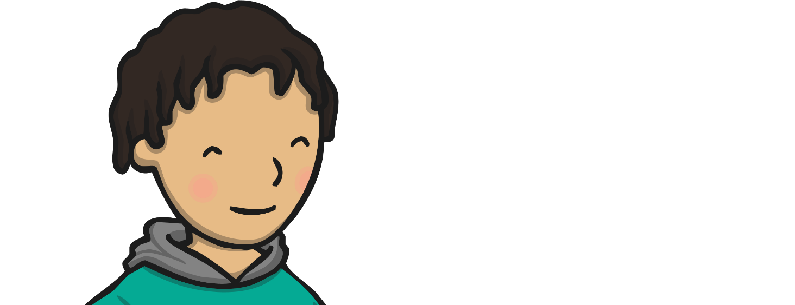
Put your beanbag on your head, on your head,
Put your beanbag on your head, on your head,
Put your beanbag on your head, standing up, look straight ahead.
Put your beanbag on your head, on your head.

Slide 5


Put your beanbag next to you, next to you,
Put your beanbag next to you, next to you,
Put your beanbag next to you, get your friend to do it too.
Put your beanbag next to you, next to you.

Slide 6


Put your beanbag underneath, underneath,
Put your beanbag underneath, underneath,
Put your beanbag underneath, can you cover what’s beneath?
Put your beanbag underneath, underneath.

Slide 7


Hold your beanbag up above, up above,
Hold your beanbag up above, up above,
Hold your beanbag up above, singing songs is what we love.
Hold your beanbag up above, up above.

Slide 8
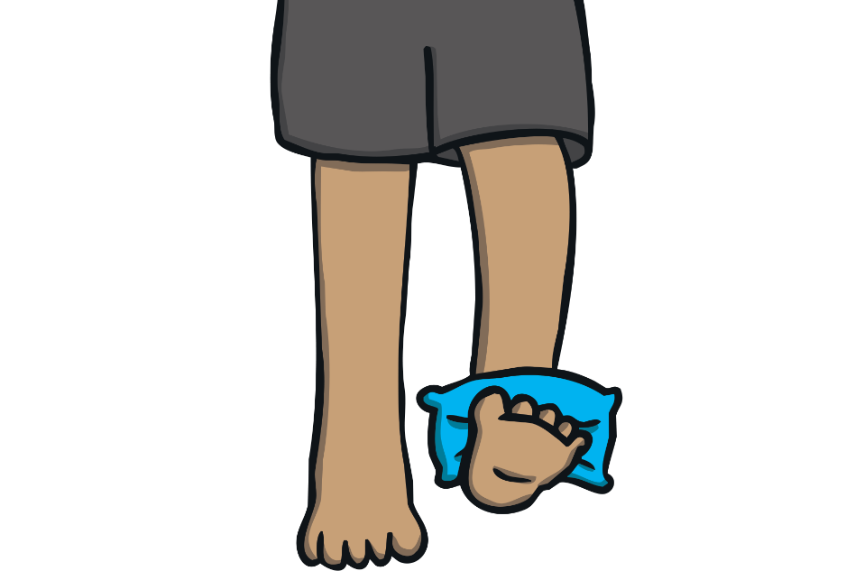
Hold your beanbag down below, down below,
Hold your beanbag down below, down below,
Hold your beanbag down below, can it really touch your toe?
Hold your beanbag down below, down below.

