Slide 2

Grouping for Division
Group the balls in 3s to find out how many nets are needed.
(9 groups into 3s).
Football nets hold 3 balls.
÷
=

Slide 3

Grouping for Division
How many baskets can be filled using the apples from the tree?
(16 grouped into 4s).
Each basket can hold 4 apples.
÷
=

Slide 4

Grouping for Division
How many packs of pencils would these pencils fill?
(15 grouped into 5s).
Pencils are sold in packs of 5.
÷
=

Slide 5

Grouping for Division
The bakery sells gingerbread people in packs of 2.
?
How many packs can be made from these gingerbread people?
÷
=

Slide 6

Grouping for Division
Mince pies are sold in boxes of 6.
?
How many boxes can be filled using these mince pies?
÷
=

Slide 7

Grouping for Division
Peppers are sold in packs of 2.
?
How many packs can be filled using these peppers?
÷
=

Slide 8

Grouping for Division
Bananas are sold in packs of 5.
?
How many packs can be filled using these bananas?
÷
=

Slide 9
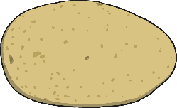
Grouping for Division
Potatoes are sold in sacks of 8.
?
How many sacks can we fill using these potatoes?
÷
=

Slide 10

Grouping for Division
Sweets are sold in packs of 9.
?
How many packs can be filled using these sweets?
÷
=

Slide 11
Grouping for Division
Sweets are sold in packs of 9.
?
How many packs can be filled using these sweets?
÷
=

Slide 12

Grouping for Division
Circle in twos and count the groups.
How many buns?
How many groups?
2
÷
=

Slide 13
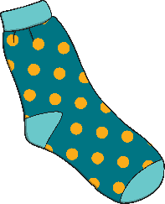
Grouping for Division
Circle in twos and count the groups.
How many socks?
How many groups?
2
÷
=

Slide 14

Grouping for Division
Circle in threes and count the groups.
How many acorns?
How many groups?
3
÷
=

Slide 15
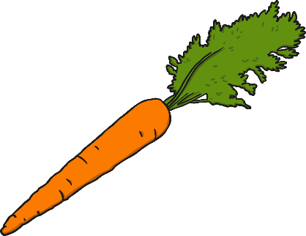
Grouping for Division
Circle in threes and count the groups.
How many acorns?
How many groups?
3
÷
=

Slide 16

Grouping for Division
Mrs Robertson has 30 glue sticks.
She groups them into fives.
?
How many groups of glue sticks can be made?

