Slide 2
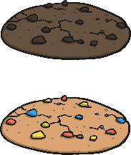



Division
Share the cookies equally between the children.
?
How many cookies do Bobby and Serena get each?
Bobby
Serena

Slide 3


Division
Share the slices of pizza equally between the plates.
?
How many slices of pizza per plate?
Plate 1
Plate 2

Slide 4




Division
Share the strawberries equally between Anne and Sanjeev.
?
How many strawberries per person?
Anne
Sanjeev

Slide 5



Division
Share the worms between the birds.
?
How many worms does each bird get?
Bird 1
Bird 2

Slide 6


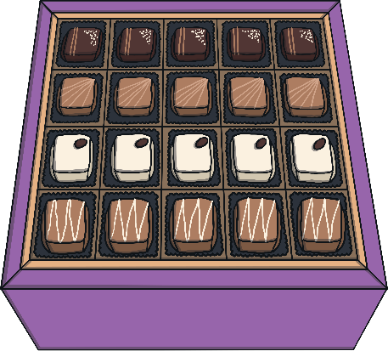
Division
There are 40 chocolates in the box.
?
How many chocolates would Mr and Mrs Gadhi each get if they are shared out equally?
Can you write the calculation?
÷
=
40 chocolates

Slide 7

Sharing Equally
Share the counters equally into two groups.
÷
=

