Slide 2
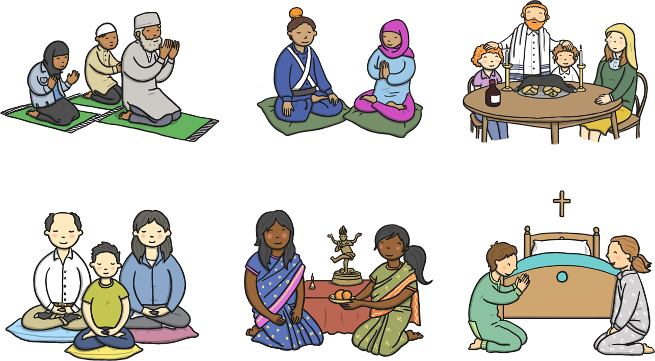
Different Beliefs

Slide 3
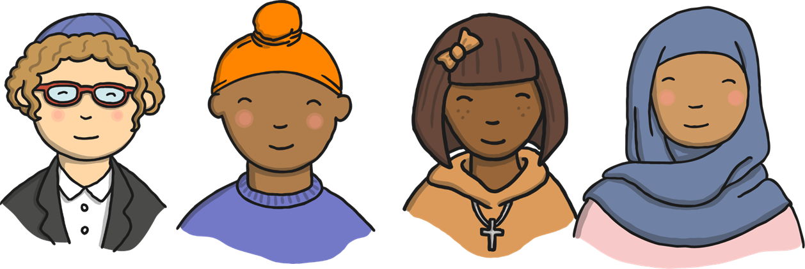
Different Beliefs
People have many different beliefs and gods that they worship.
They may have different clothes and pray in different ways in different places but everyone is special!

Slide 4
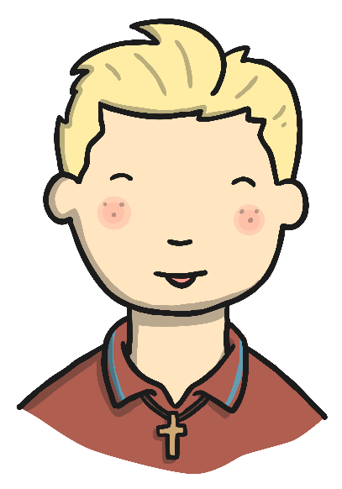
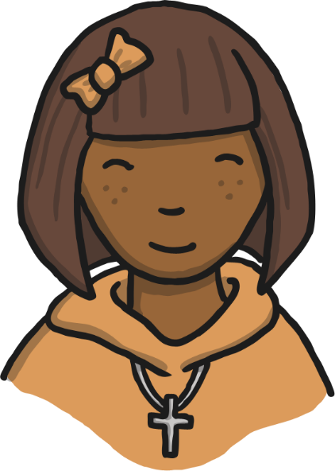
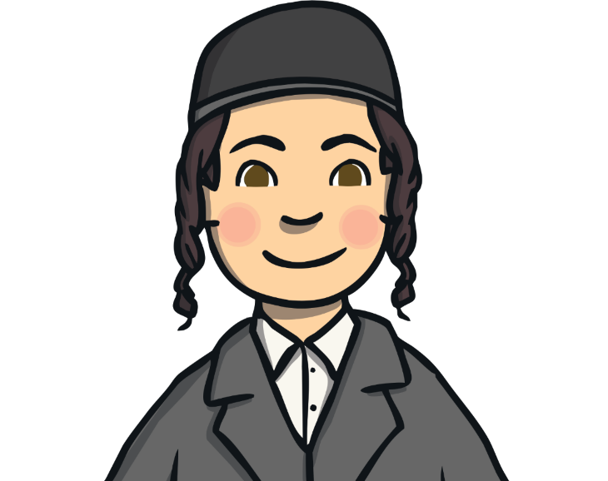
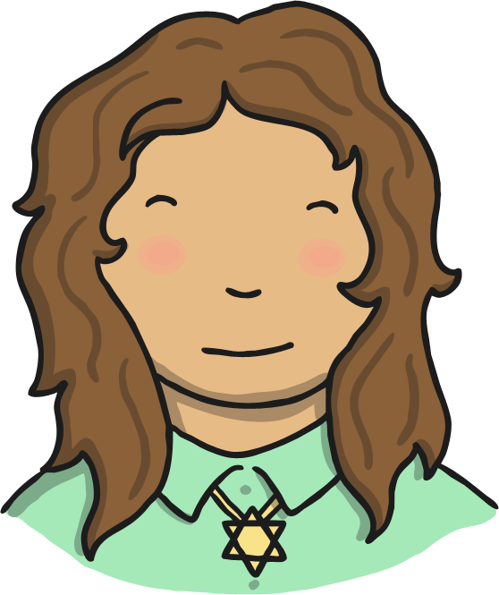
Some Christian children like to wear a cross
and chain.
Some Jewish children like to wear a Magen David (star of David).
Some Jewish boys wear a kippah.

Slide 5

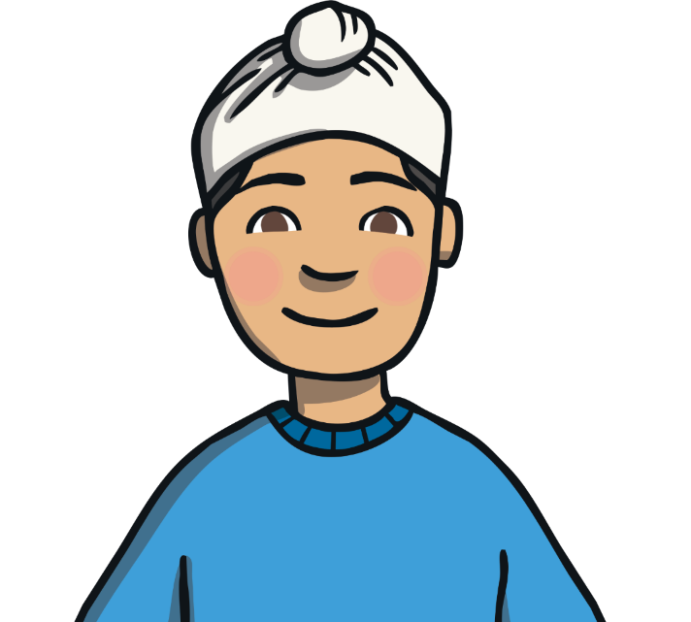
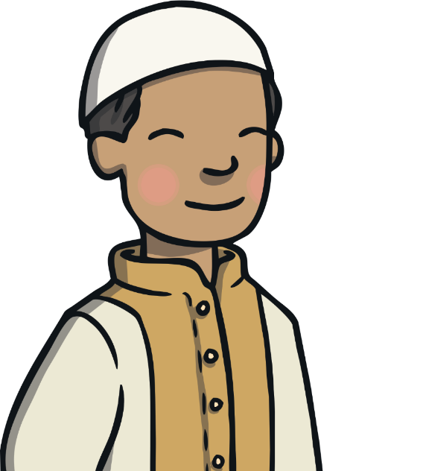
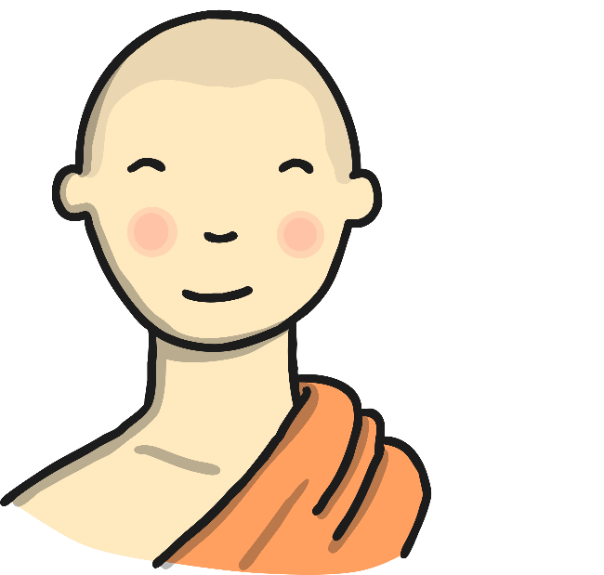
Some Sikh boys like to have their hair short. Some Sikh boys wear a patka over their hair.
Some Muslim Boys like to wear a topi on their head.
Some Buddhist boys like to have their head shaven.

Slide 6

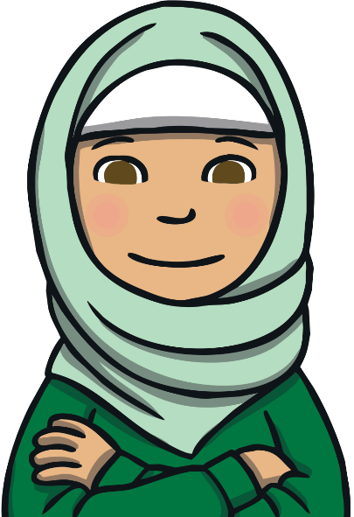
Sometimes, you can see things in different religions which are quite similar to others.
A Christian girl may wear a headdress to their first communion which covers their hair.
A Muslim girl may wear a hijab which covers their hair also.

Slide 7
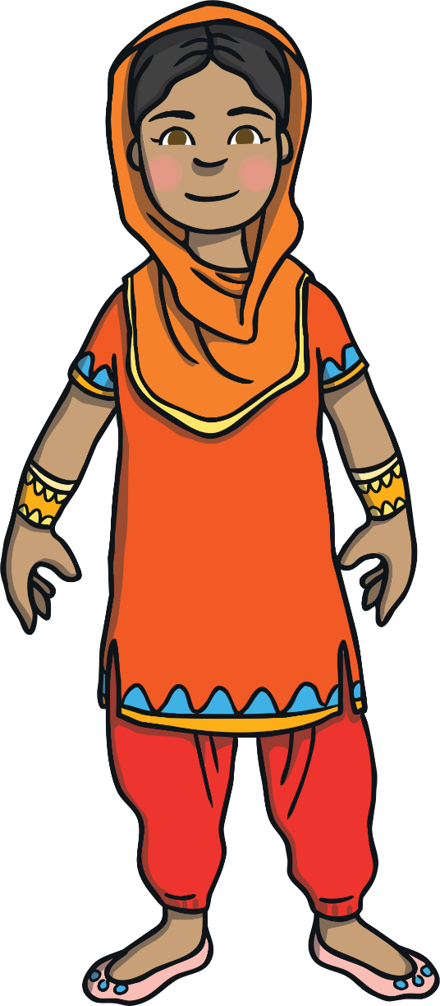
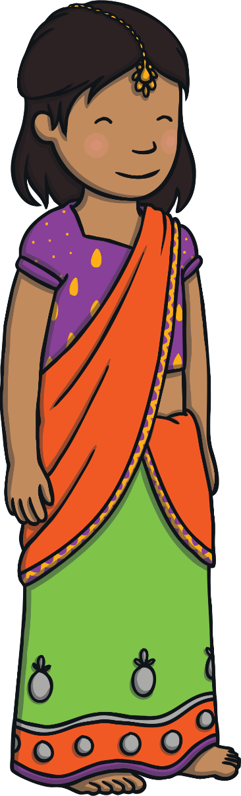
Some Sikh girls wear shalwar kameez.
Some Hindu girls wear a sari.

Slide 8
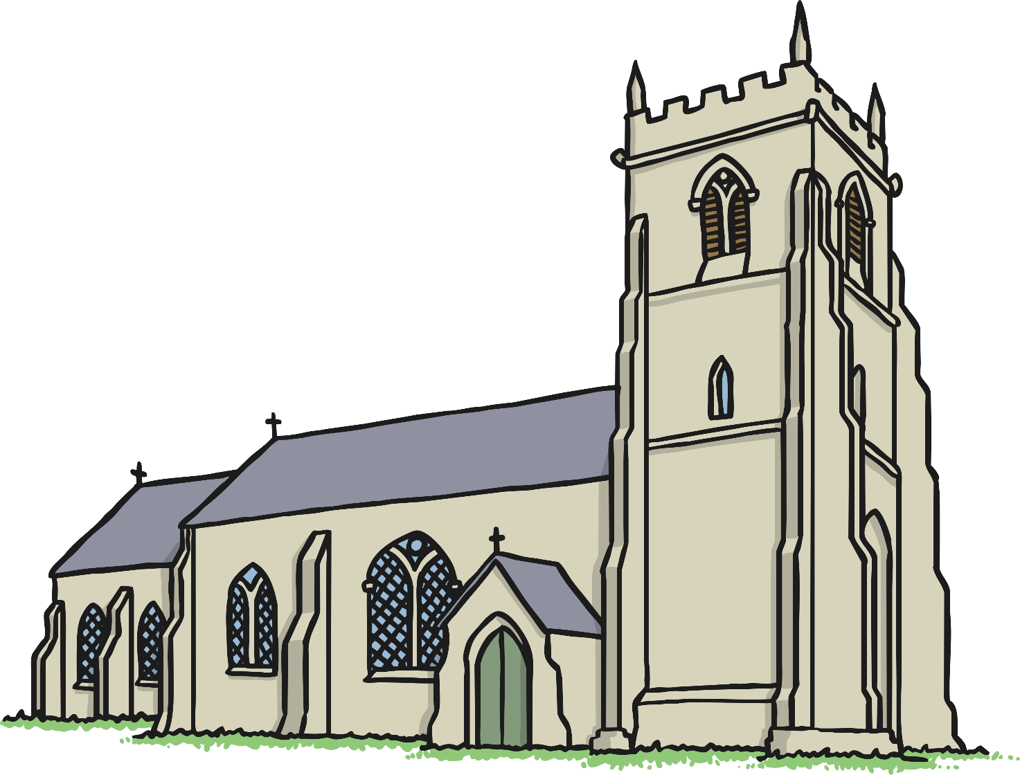
Christians worship in a church.

Slide 9
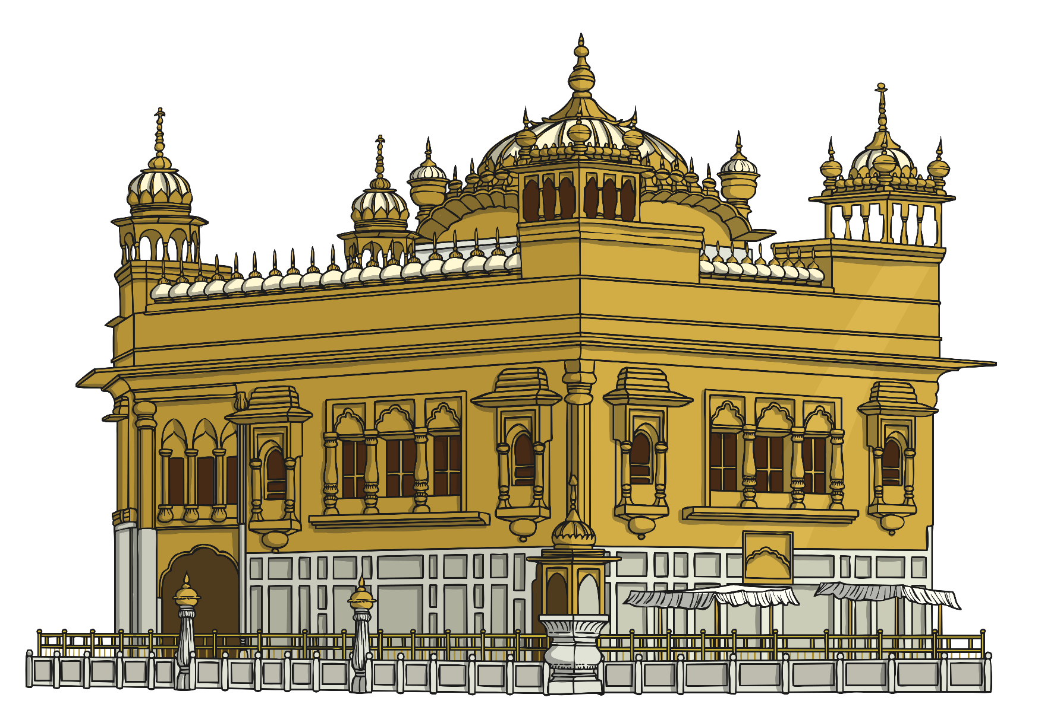
Sikhs worship at a gurdwara.

Slide 10
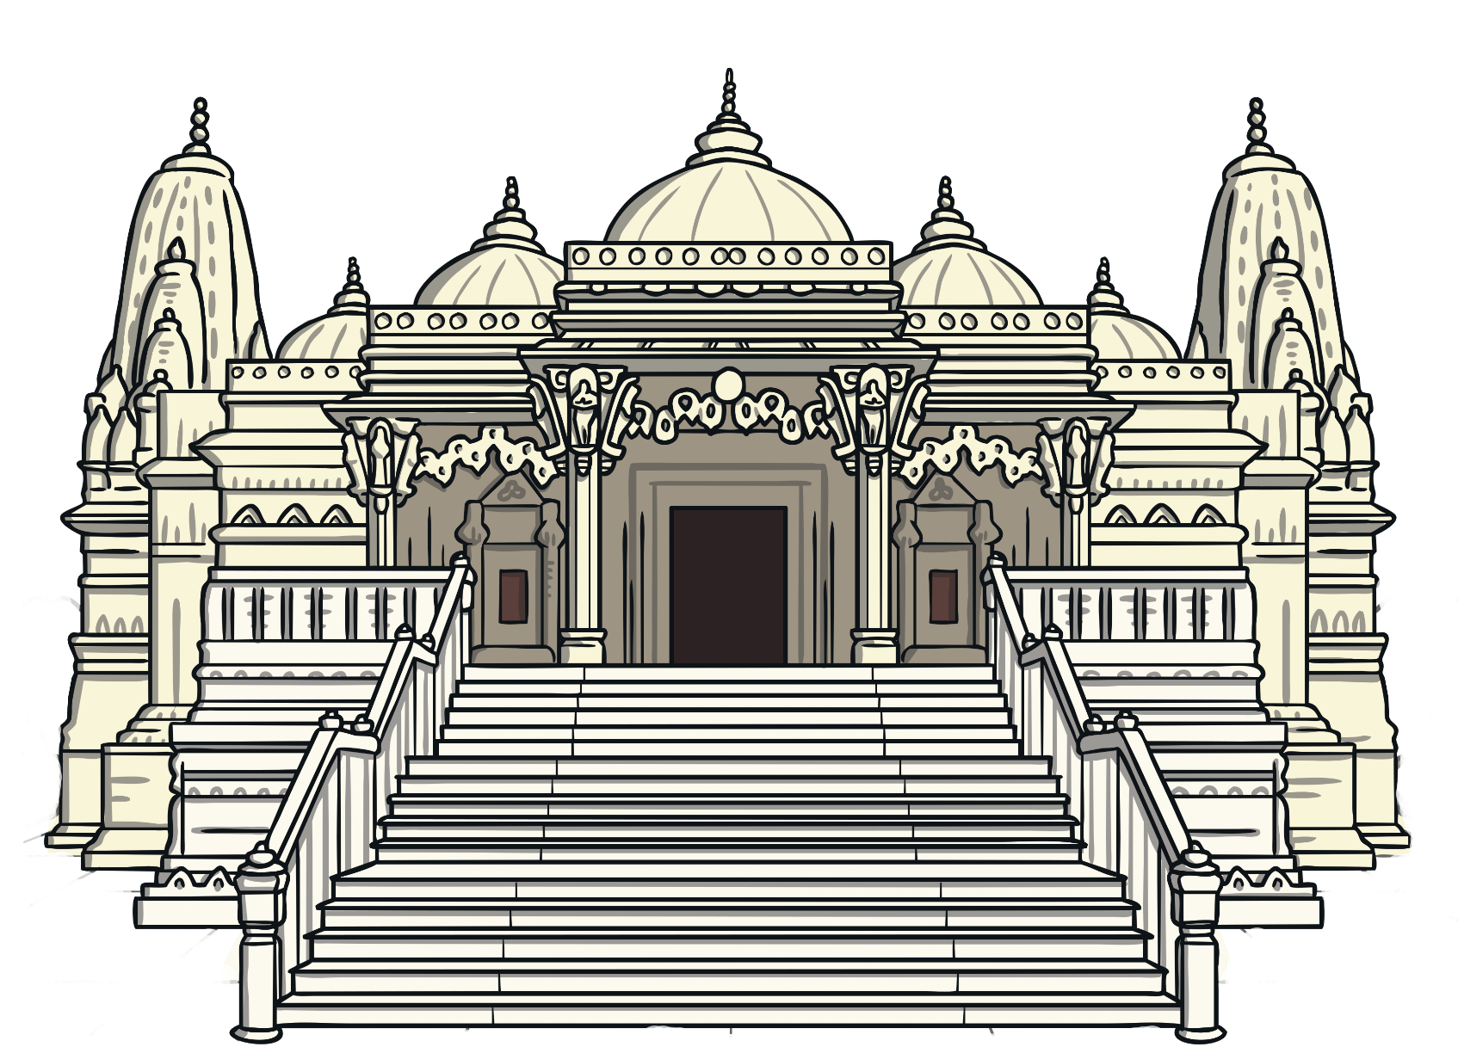
Hindus worship in a mandir.

Slide 11
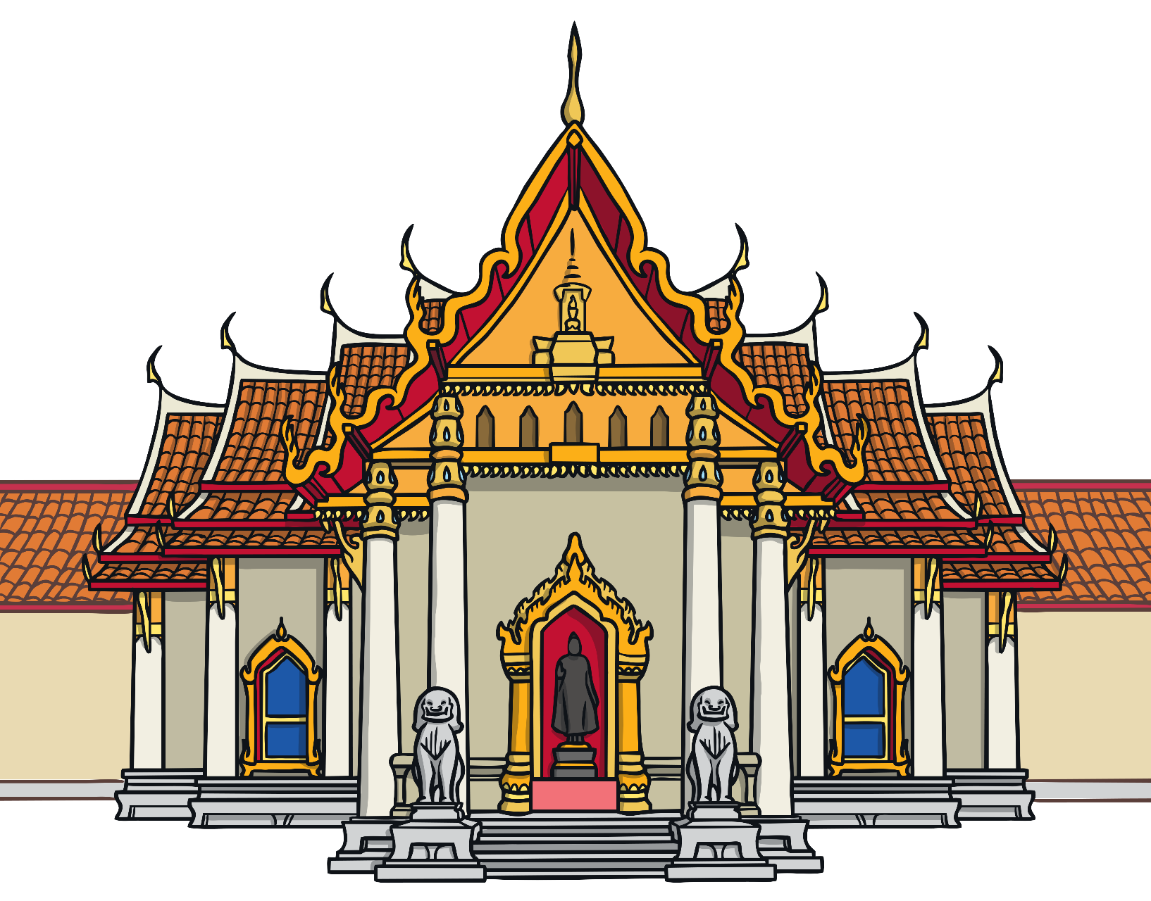
Buddhists worship in a wat.

Slide 12
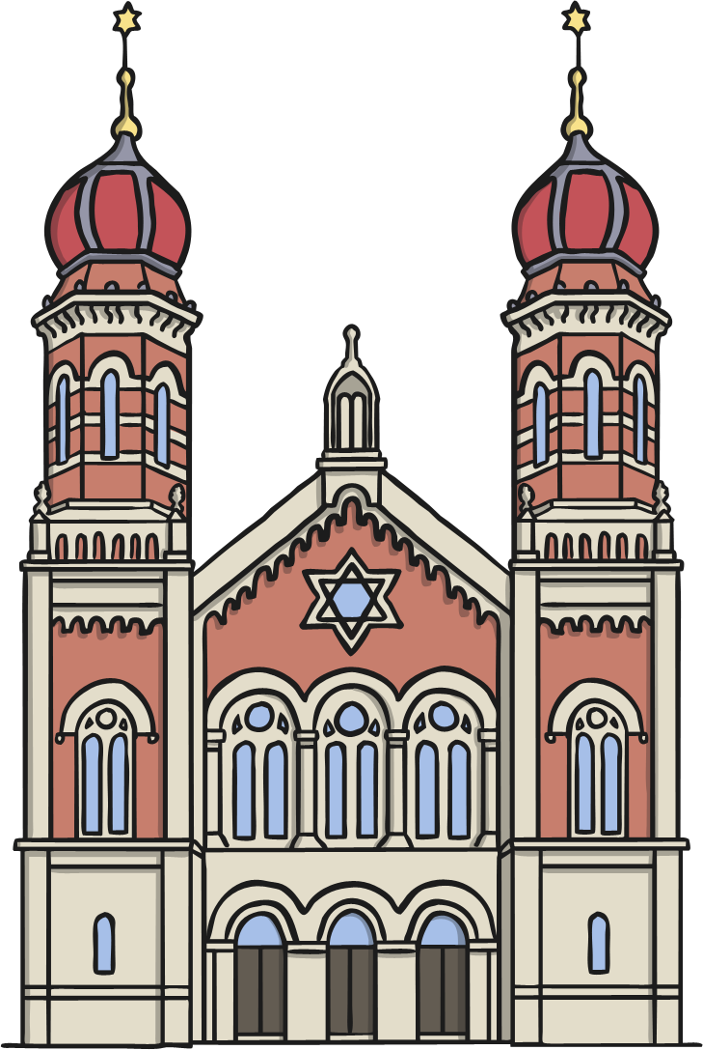
Jews worship in a synagogue.

Slide 13
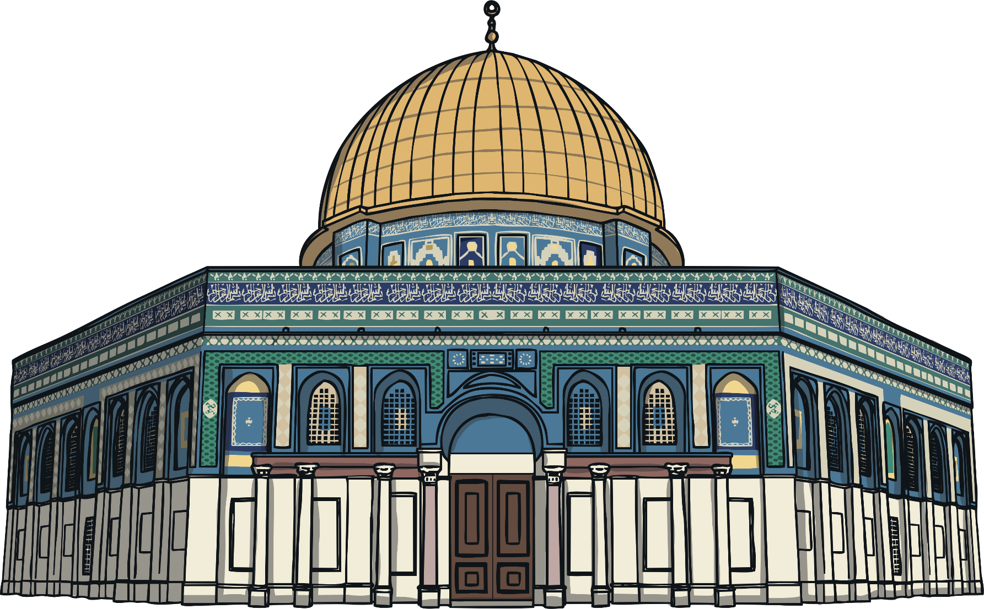
Muslims worship in a mosque.

Slide 14
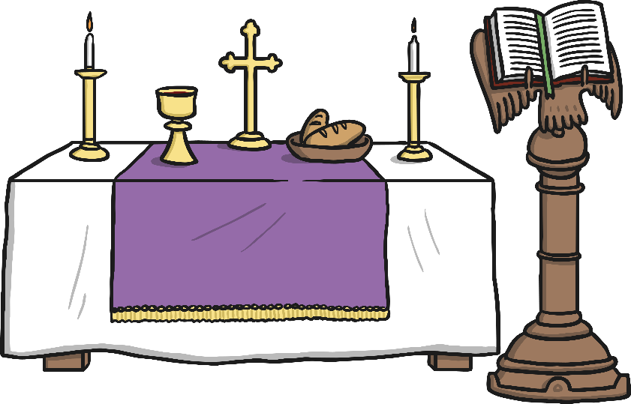
Inside a Church
Table called the altar
Chalice cup with red wine
Bowl with bread or wafers
Holy book called the Bible
4
2
3
1

Slide 15
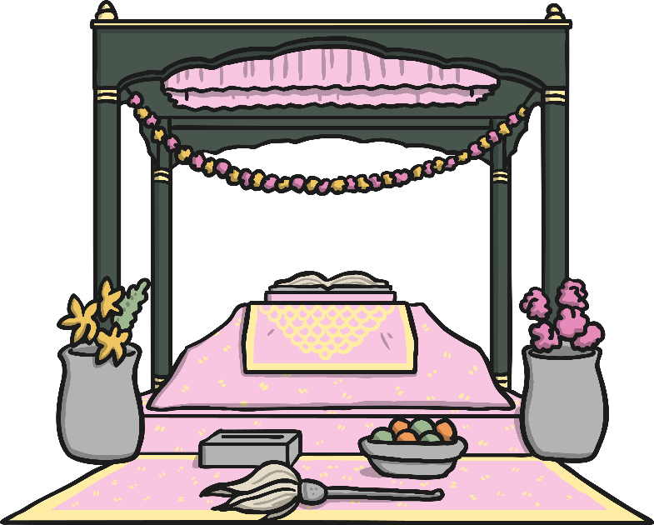
Inside a Gurdwara
Silk cloth called a romala covering the Guru Granth Sahib
Fan called a chauri
Canopy
Money donation box
Offering of fruit
3
1
4
5
2

Slide 16
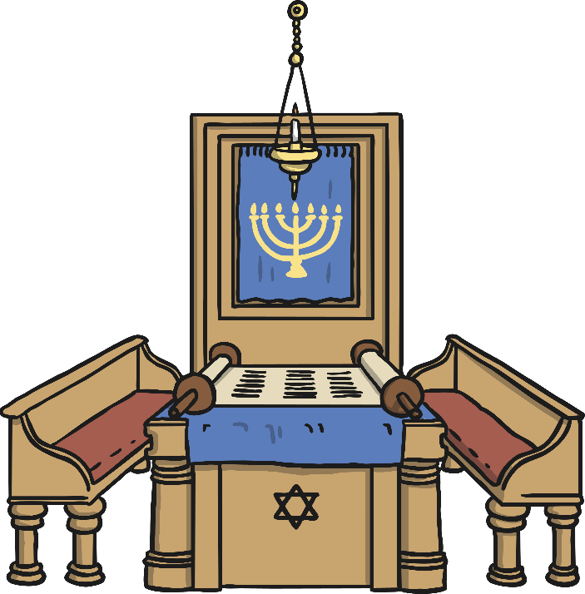
Inside a Synagogue
1
Light called the ner tamid
Cupboard called the ark
Curtain with a candlestick called a menorah on it.
Jewish Holy Book called the Torah
Torah scrolls covered by curtain
Magen David (Star of David)
2
3
5
4
6

Slide 17
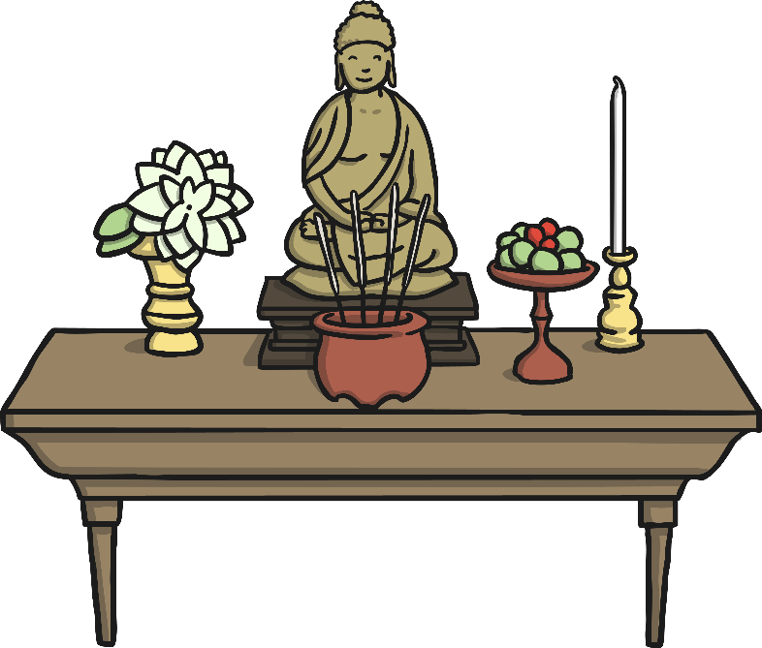
Inside a Wat
Statue of Buddha
Candles
Vase of flowers
Incense
Offering of fruit
1
2
3
5
4

Slide 18
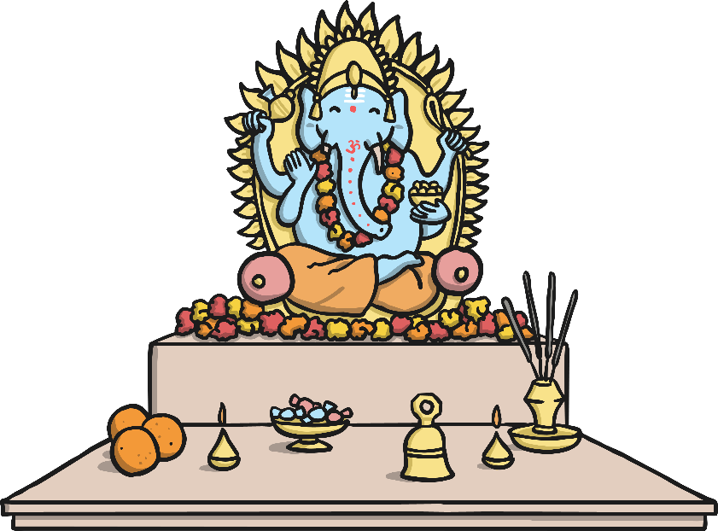
Inside a Mandir
Ganesh, the God for good luck
Bowl of sweets
Orange fruit
Sacred flame
Prayer bell
Incense
1
4
5
6
3
2

Slide 19
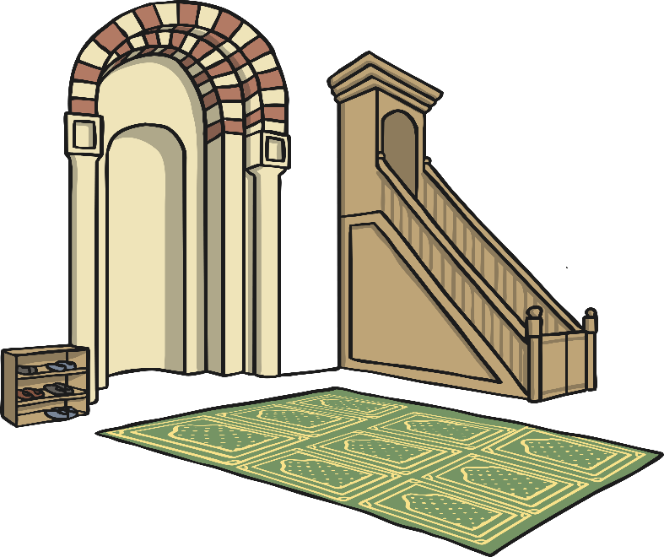
Inside a Mosque
Arch marking the direction of Mecca called a mihrab
Platform where the Imam gives his talk called a minbar
Prayer mat facing the mihrab
Shoe rack
1
2
4
3

Slide 20
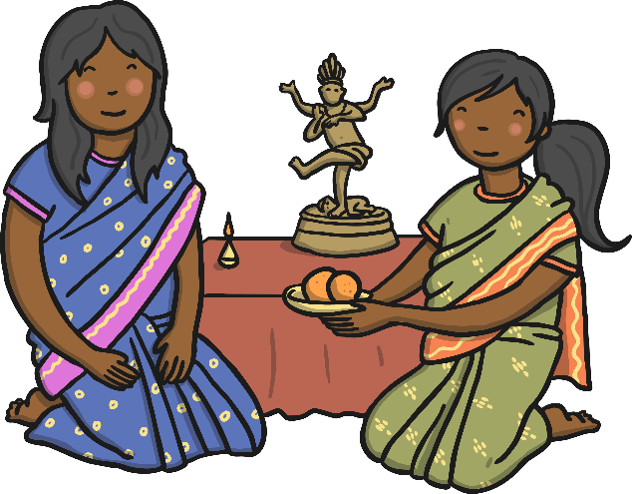
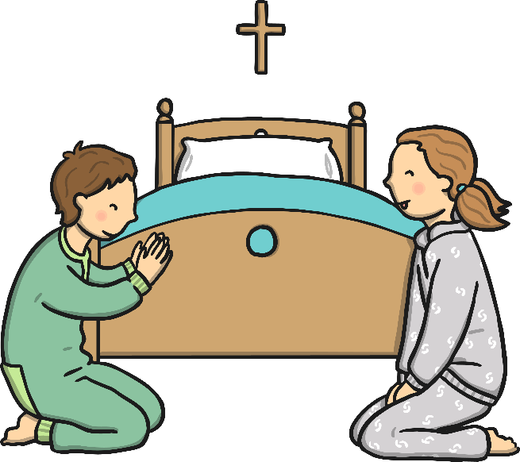
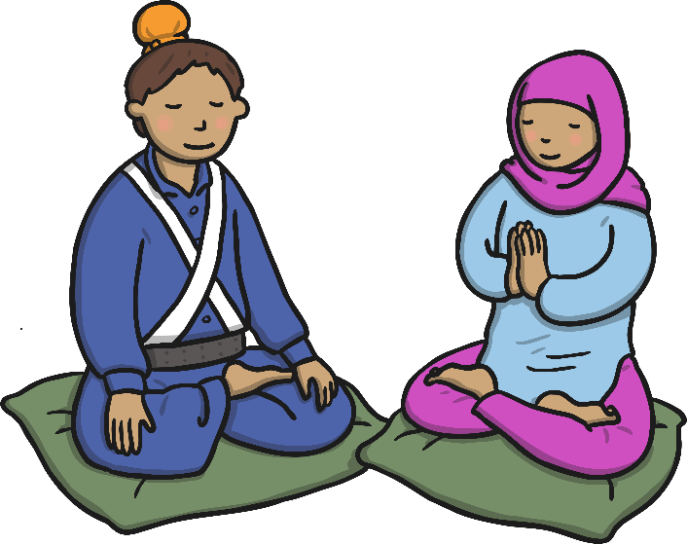
◄ In a Hindu home, many girls help their mothers set up the family shrine each morning.
► In a Sikh home, children usually say prayers in the mornings and evenings.
▲ In a Christian home, some children will say prayers before they go to bed.

Slide 21
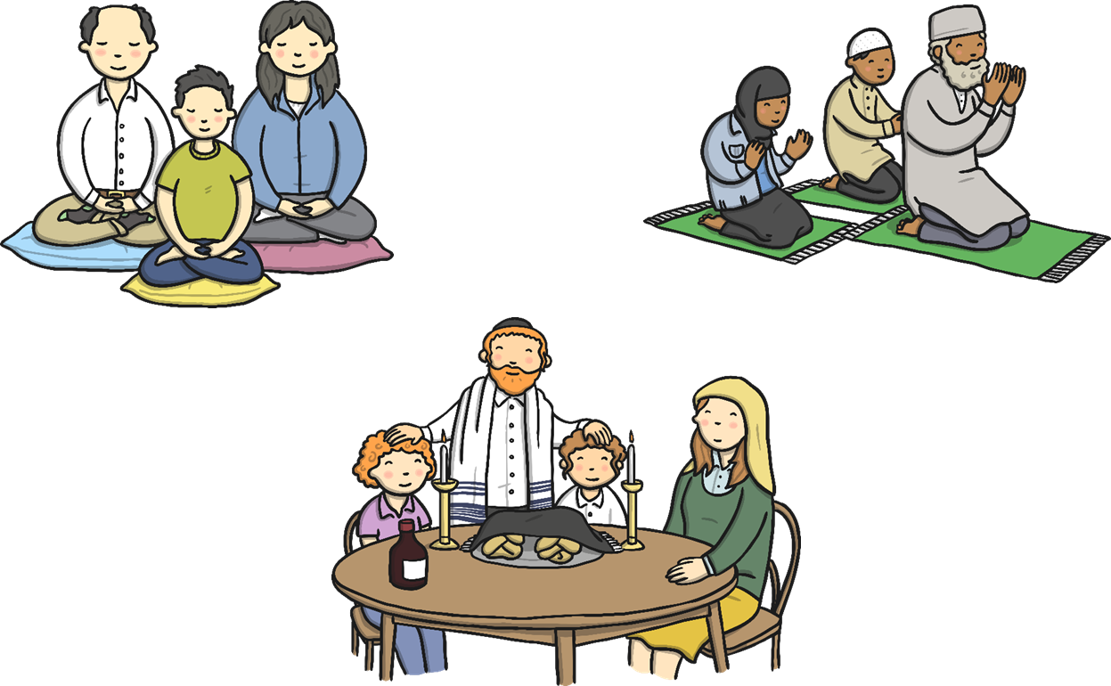
◄ In a Buddhist home, the family may meditate in silence.
► In a Jewish home, a family meal is usually eaten every Friday evening and the father blesses his children.
▲ In a Muslim home, it is usually the Father that leads the family prayers every morning and evening.

Slide 22
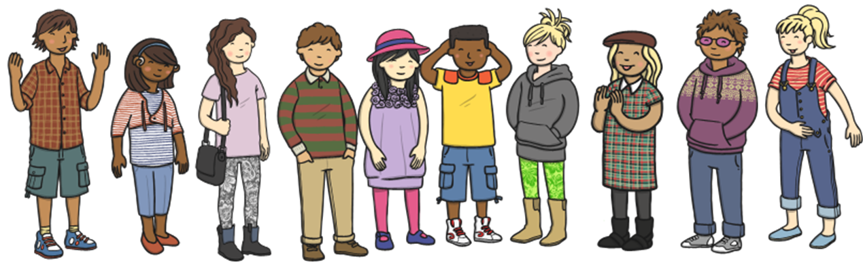
Be lovely to everyone, no matter what they believe in.

